Slide 1

CEIS110
PROGRAMMING WITH DATA
PRESENTED
BY: MARYAM ZISHAN

Slide 2

Large amounts of data are gathered everyday and require proper storage, management, analysis, security, etc. This project includes analysis of a weather data using Python that has been gathered from a cloud data source. I will primarily be focusing on temperature and humidity in this weather data course project.
Introduction

Slide 3
Software Inventory
The following software must be downloaded before starting the weather data programming:
EXCEL
SQLite Studio
Python IDE-anaconda

Slide 4
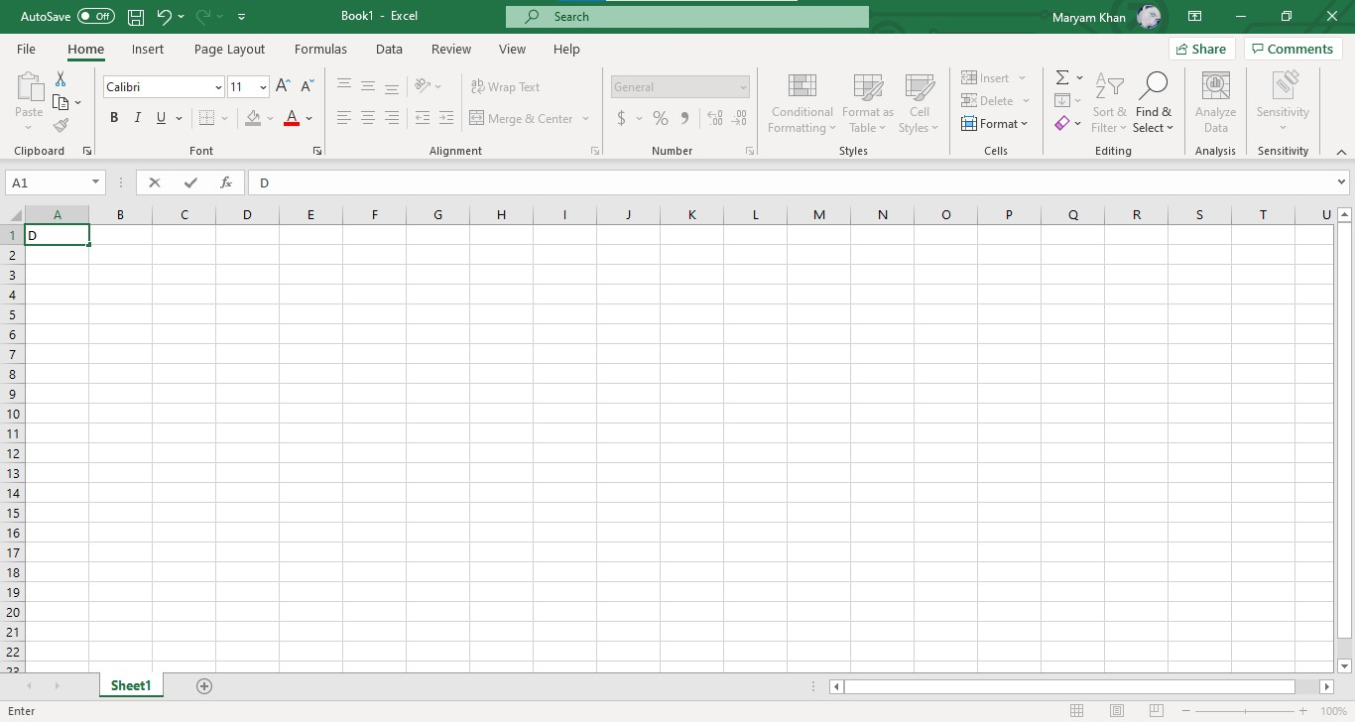
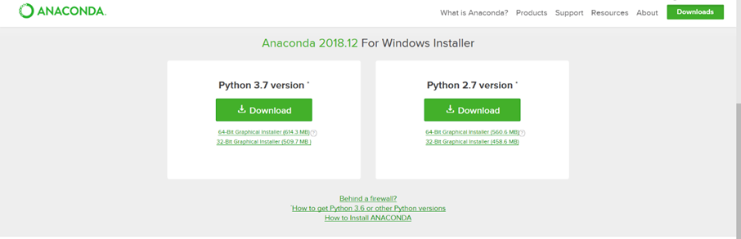
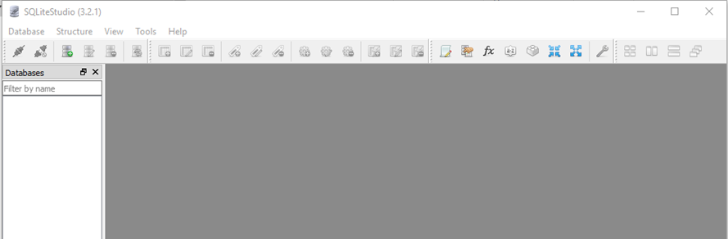
The software includes:
Microsoft Excel
Anaconda Navigator with Spider
SQLite

Slide 5
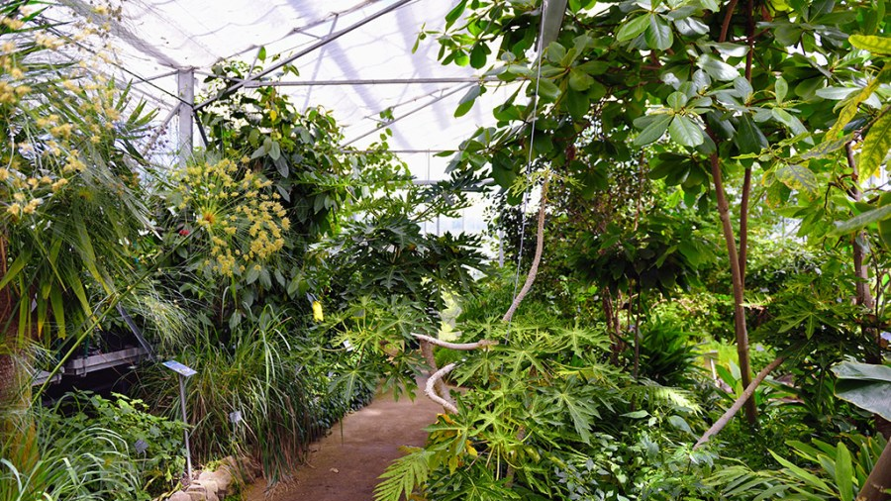
Planning and Design
After software extraction a flow chart was created to further execute the successful development of the project. A proper understanding and step by step processing is an essential part of any project.

Slide 6

What are Flowcharts
Flowcharts are graphical representations of processes or workflows. A flowchart was developed to determine the output of this project as it’s an essential component for successful execution of the project. Many companies use and is very common.

Slide 7
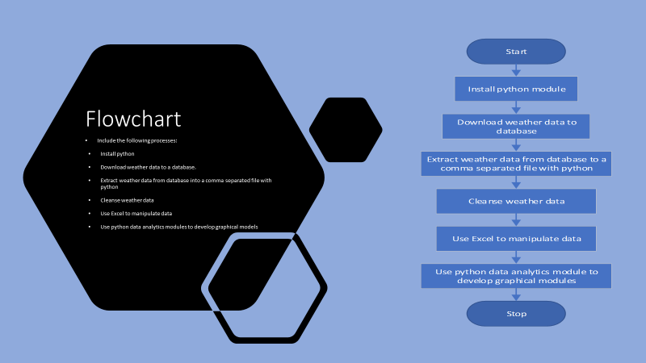

Slide 8
Adding Library
A library was added to connect Python with the US government National Oceanic and Atmospheric Administration(NOAA) weather data services. This was done by the help of a cloud-based Application Programming Interface(API). Next slide showcases the screenshot of the library module that was installed in order to use the services.

Slide 9
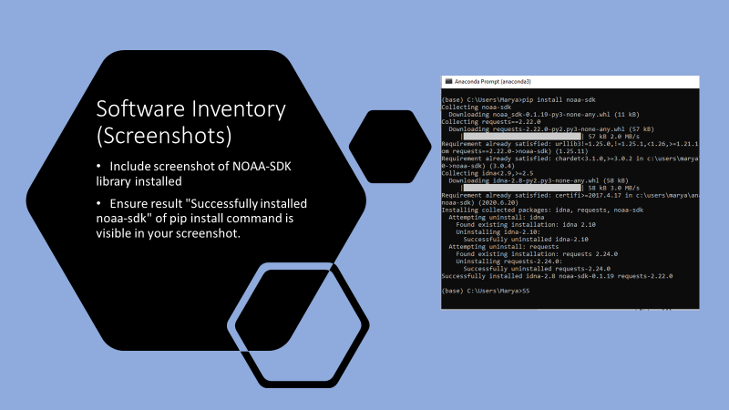

Slide 10

Downloading Weather Data of Teperature & Humidity
To further the process a code was created to download a set of weather Observations ina local data base for later analysis

Slide 11
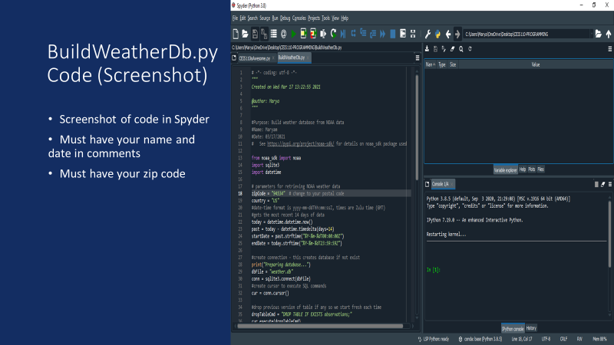

Slide 12
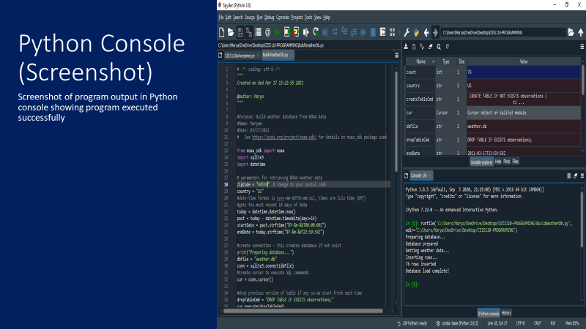

Slide 13
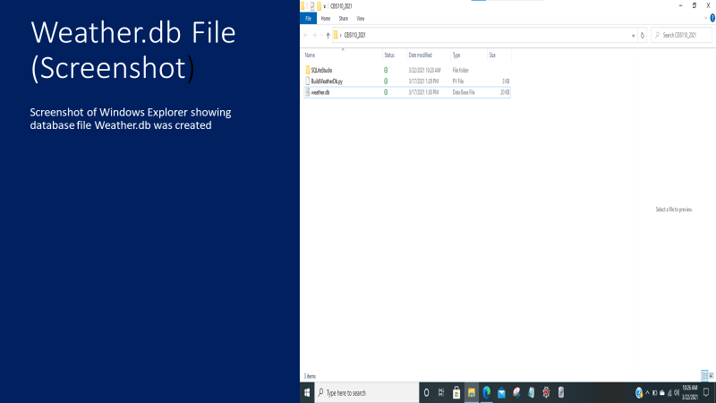

Slide 14
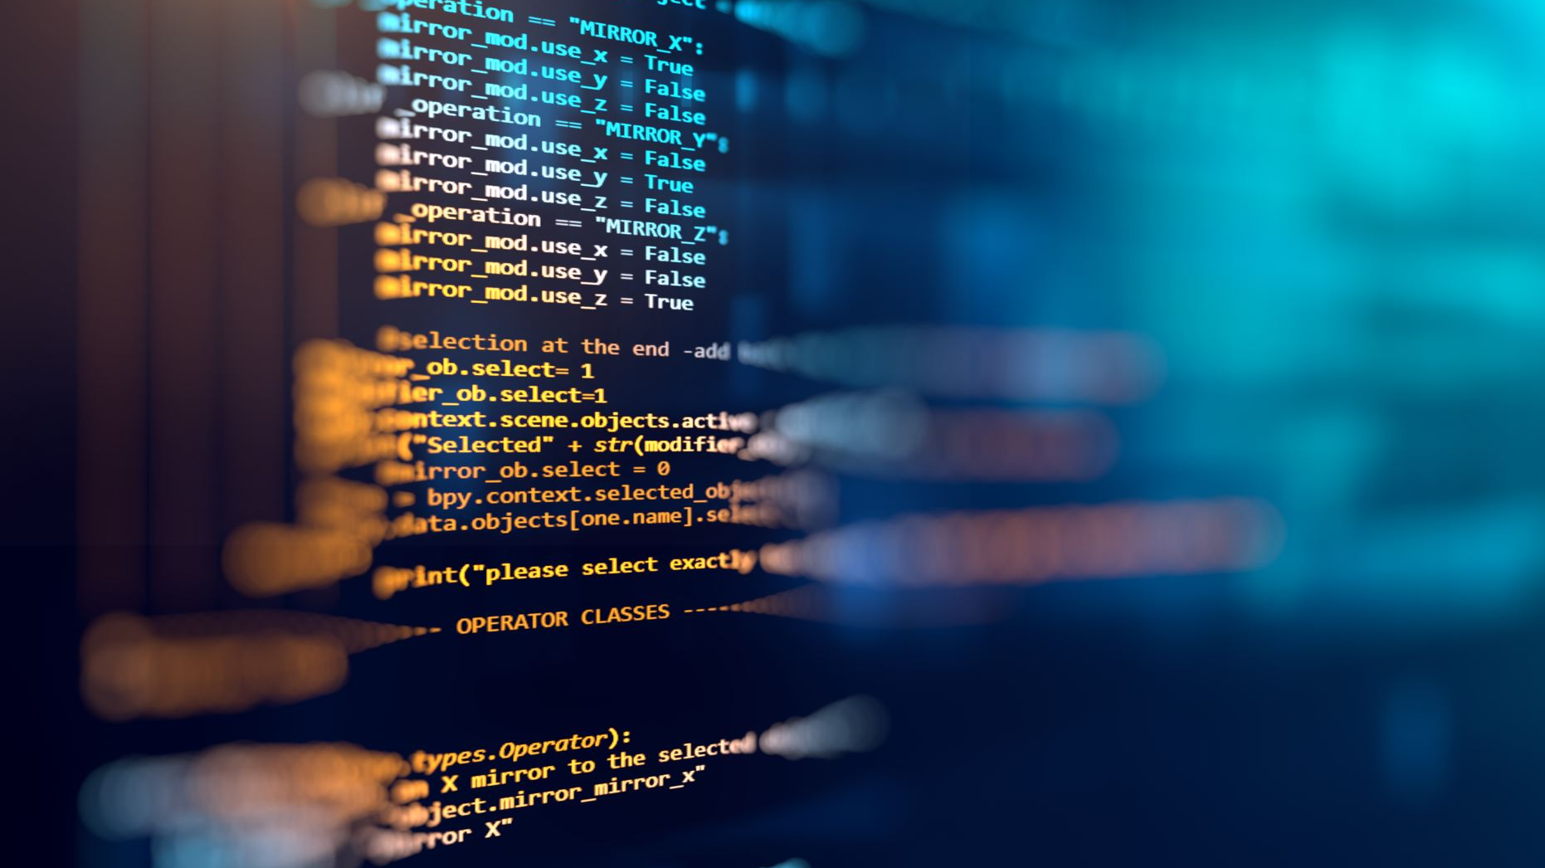
Querying the database with SQL
A Structured Query Language(SQL) is a programming language used for working with relational database. An SQLite studio was used to query the database and view the results.

Slide 15

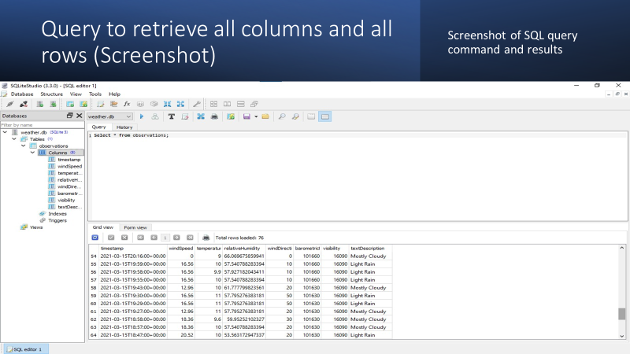
In order to retrieve data from all rows and columns a SQL command “select* from observations” was executed.

Slide 16
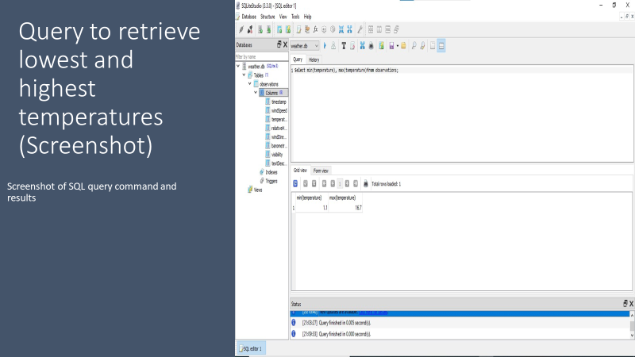

Slide 17

Data Cleansing
Since machines are as prone to errors as humans, we must make sure its data is clearly evaluated and checked thoroughly for it to be standardized, complete and cleansed! Programmers can easily put data in a format that can easily be rad by another programmer. Here a Python programmer is saving a python program data file called csv in a way that it can be read by Excel.

Slide 18
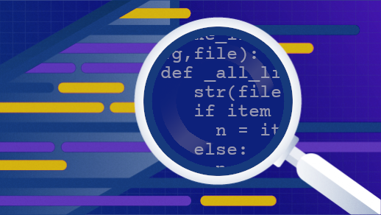
This Photo by Unknown Author is licensed under CC BY-SA

Slide 19
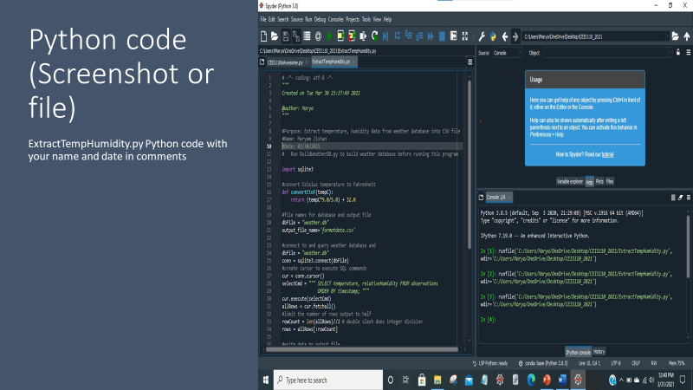
The weather.db database may contain null or missing values. The code used retrieves only the temperature and humidity values and writes them to comma separatedvalues(CSV) file. Two files are created-a formatdata.csv and a formatdata2.csv that each contained half of the row. Missing and null values will not be included in the file.

Slide 20
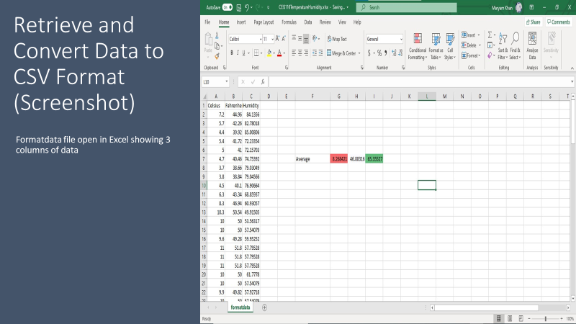
This file called a formatdata.csv contains 3 coulumns Celsius, Fahrenheit, and Humidity and various statistics can be performed on this spreadsheet!

Slide 21
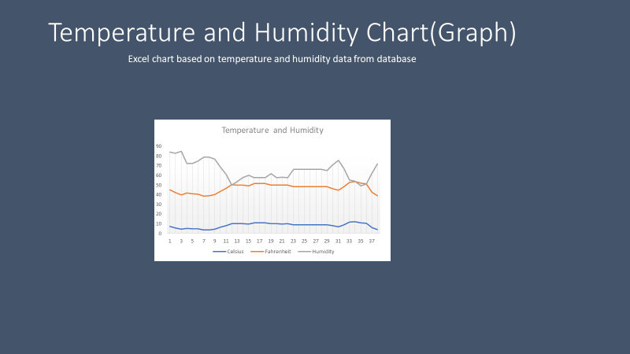
Data Visualization

Slide 22

Data Analytics
Through this users can create graphs and charts to showcase their data that can be altered and save into tabular format. These are data analytical modules that are available as a part of Anaconda and can help generate predictions after analyzing several plots of humidity and temperature over a certain period of time.

Slide 23
Develop Graphical Models and Interpret Results

Slide 24
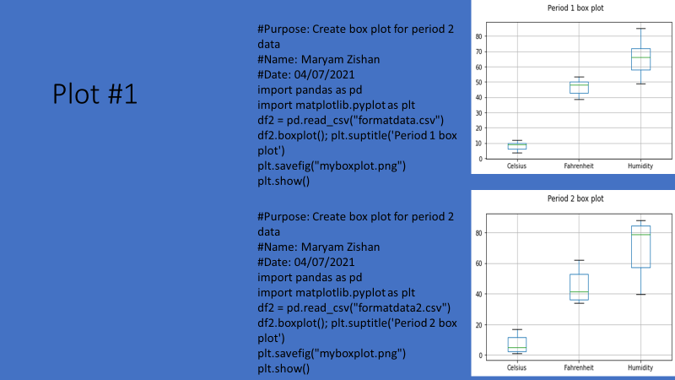

Slide 25
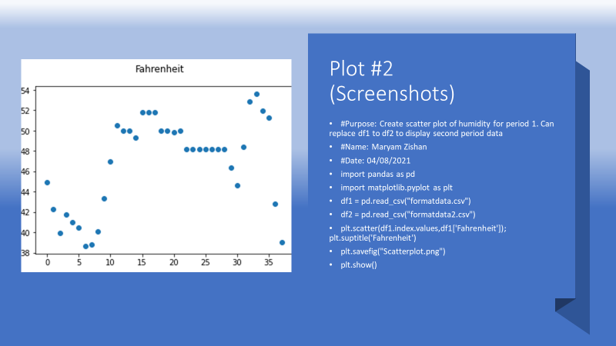

Slide 26
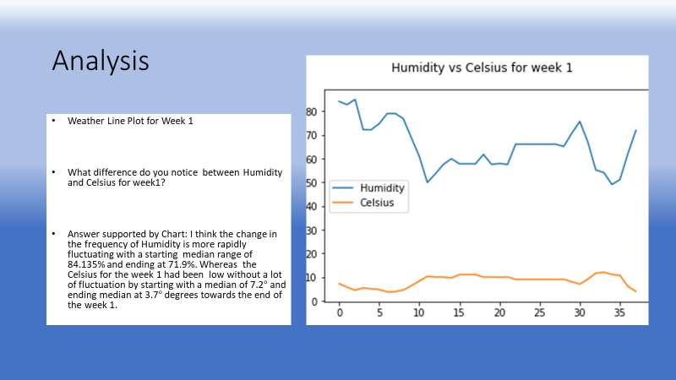

Slide 27
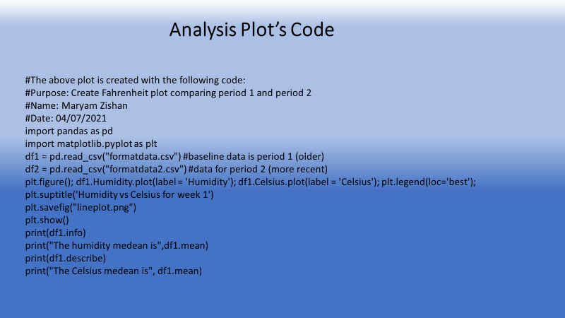

Slide 28
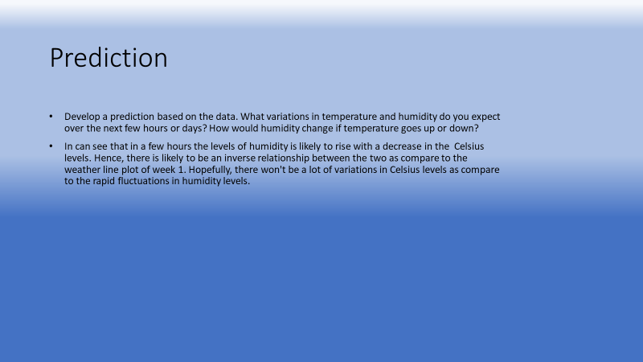

Slide 29

Challenges
As a beginner it was very challenging experience for me. Below is the list of challenges that I had to face:
1. I created different directories for weather.db
2 .There were a lot of errors such as syntax.
3. Code was not copied completely and would result in errors

Slide 30

Career Skills
Basic career skills that I acquire through this project are:
1.Database Development
2. Programming using Python
3. Planning and designing
4.Creating flowcharts
5. Troubleshooting errors in the database
6. Data visualization, analytics and cleansing
7. Thinking with patience before proceeding.
8. Importance of programming in IoT

Slide 31

Conclusion
With basic understanding of Programming in Python I feel more confident about my career in IT.
Eventually I find programming very interesting, and I believe all programmers must be very intelligent and hardworking to be able excel in this field.

