Slide 1

CEIS101 COURSE PROJECT
SMART HOME AUTOMATION AND SECURITY SYSTEM
Presented BY: Maryam zishan

Slide 2
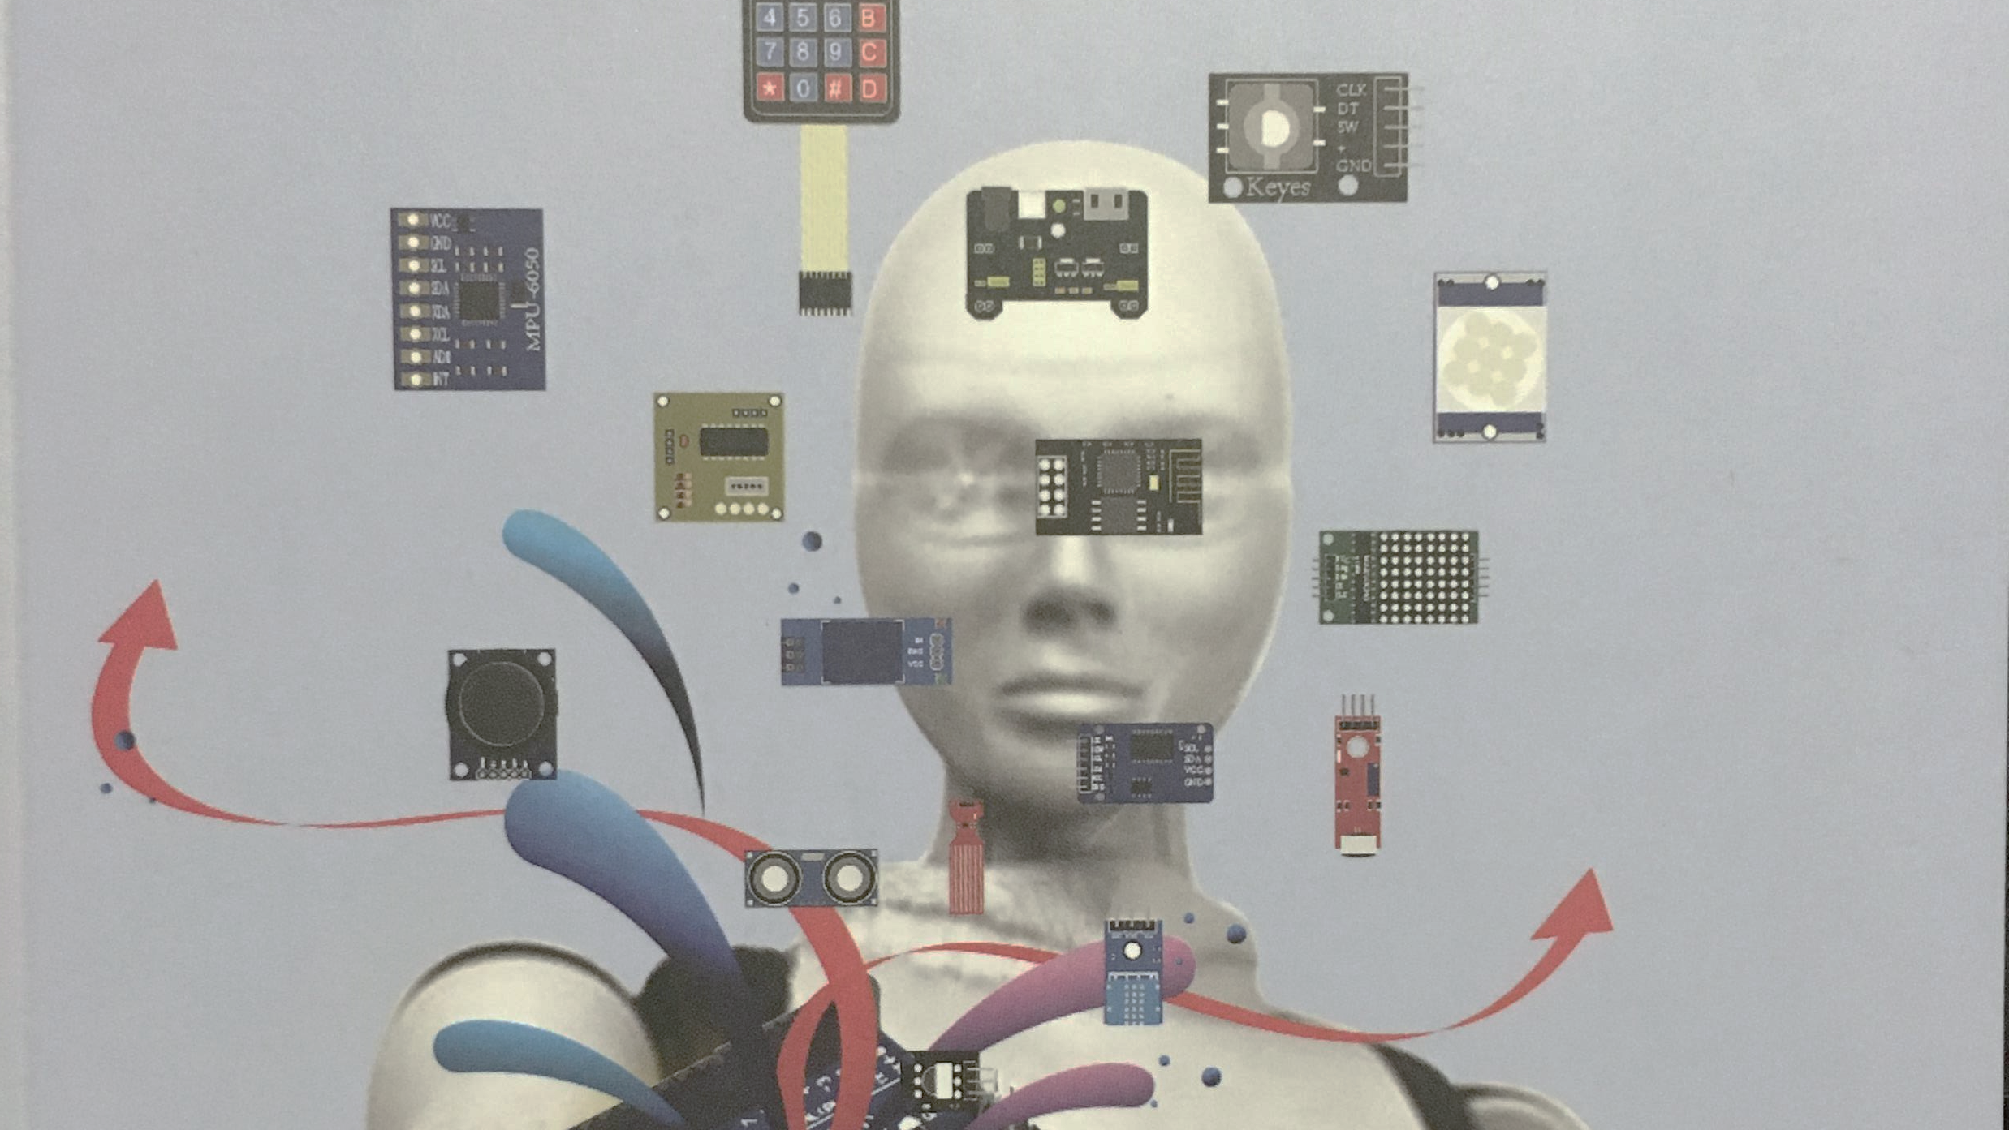
Introduction
.
Develop a Smart Home Automation and Security System by:
Designing the prototype in Tinkercad
Building the hardware with the components from the IoT Tech Core Kit
Programming within Arduino IDE
Various components will be used to activate a successful smart home system such as:
A door sensor to check whether the door is open or close
A distance sensor to monitor for a possible home intruder
Automated lights that turn on when it is dark
Water level sensor to monitor for possible flooding
Temperature and humidity sensor to monitor the weather condition

Slide 3


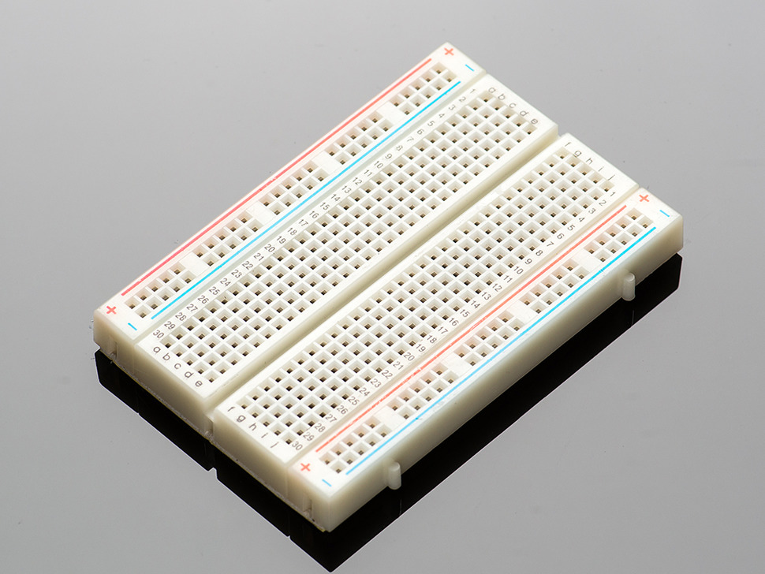
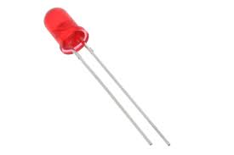
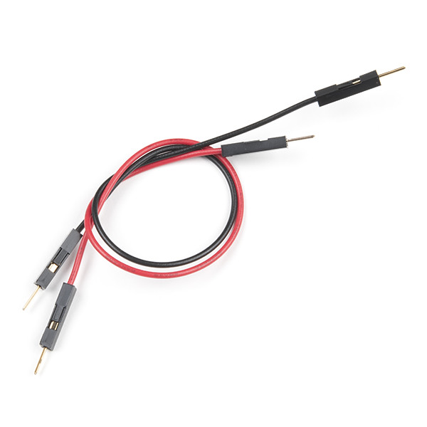
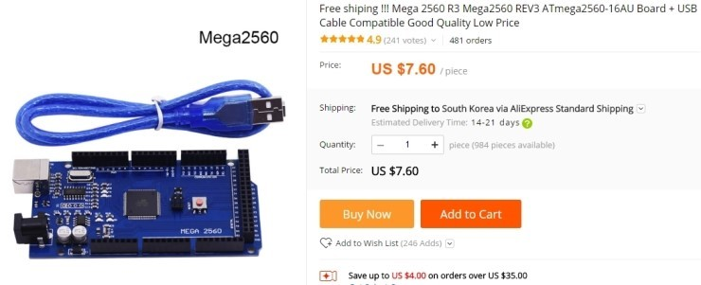
CIRCUIT SIMULATION IN TINKERCAD

Slide 4
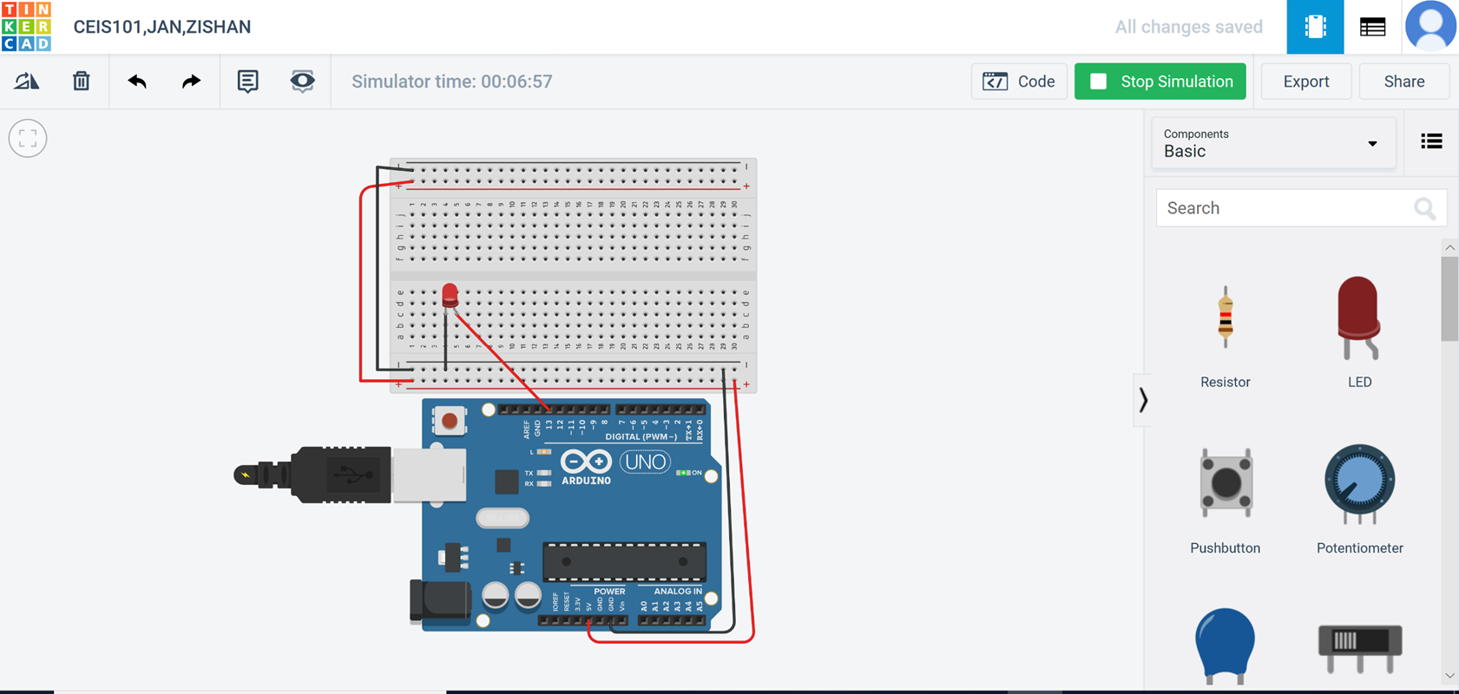
CIRCUIT (SCREENSHOT)

Slide 5
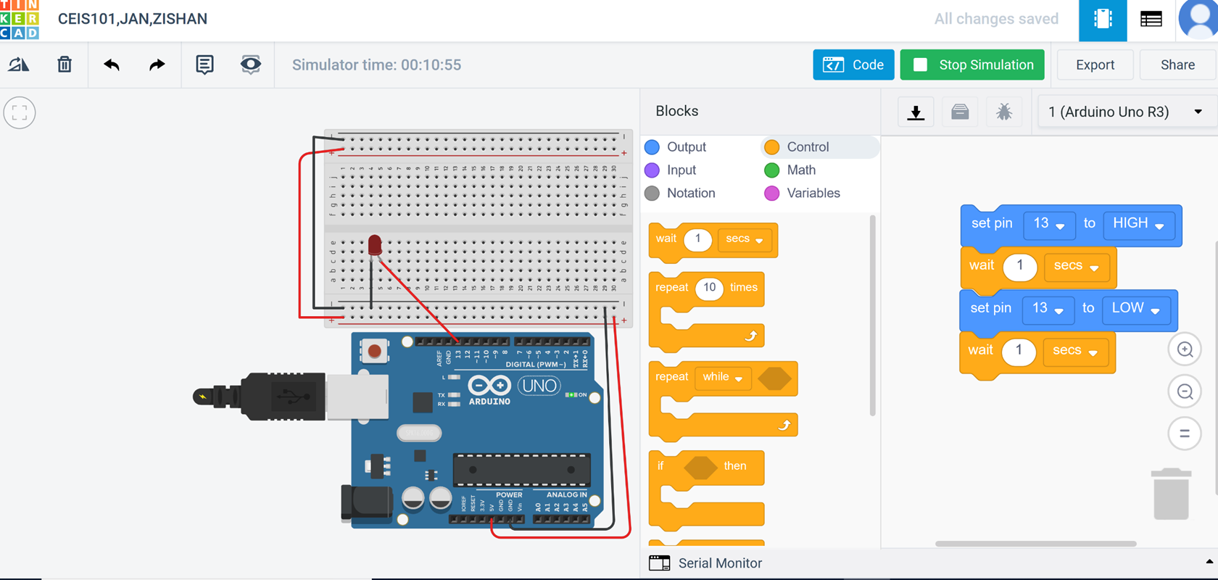
CODE (SCREENSHOT)

Slide 6
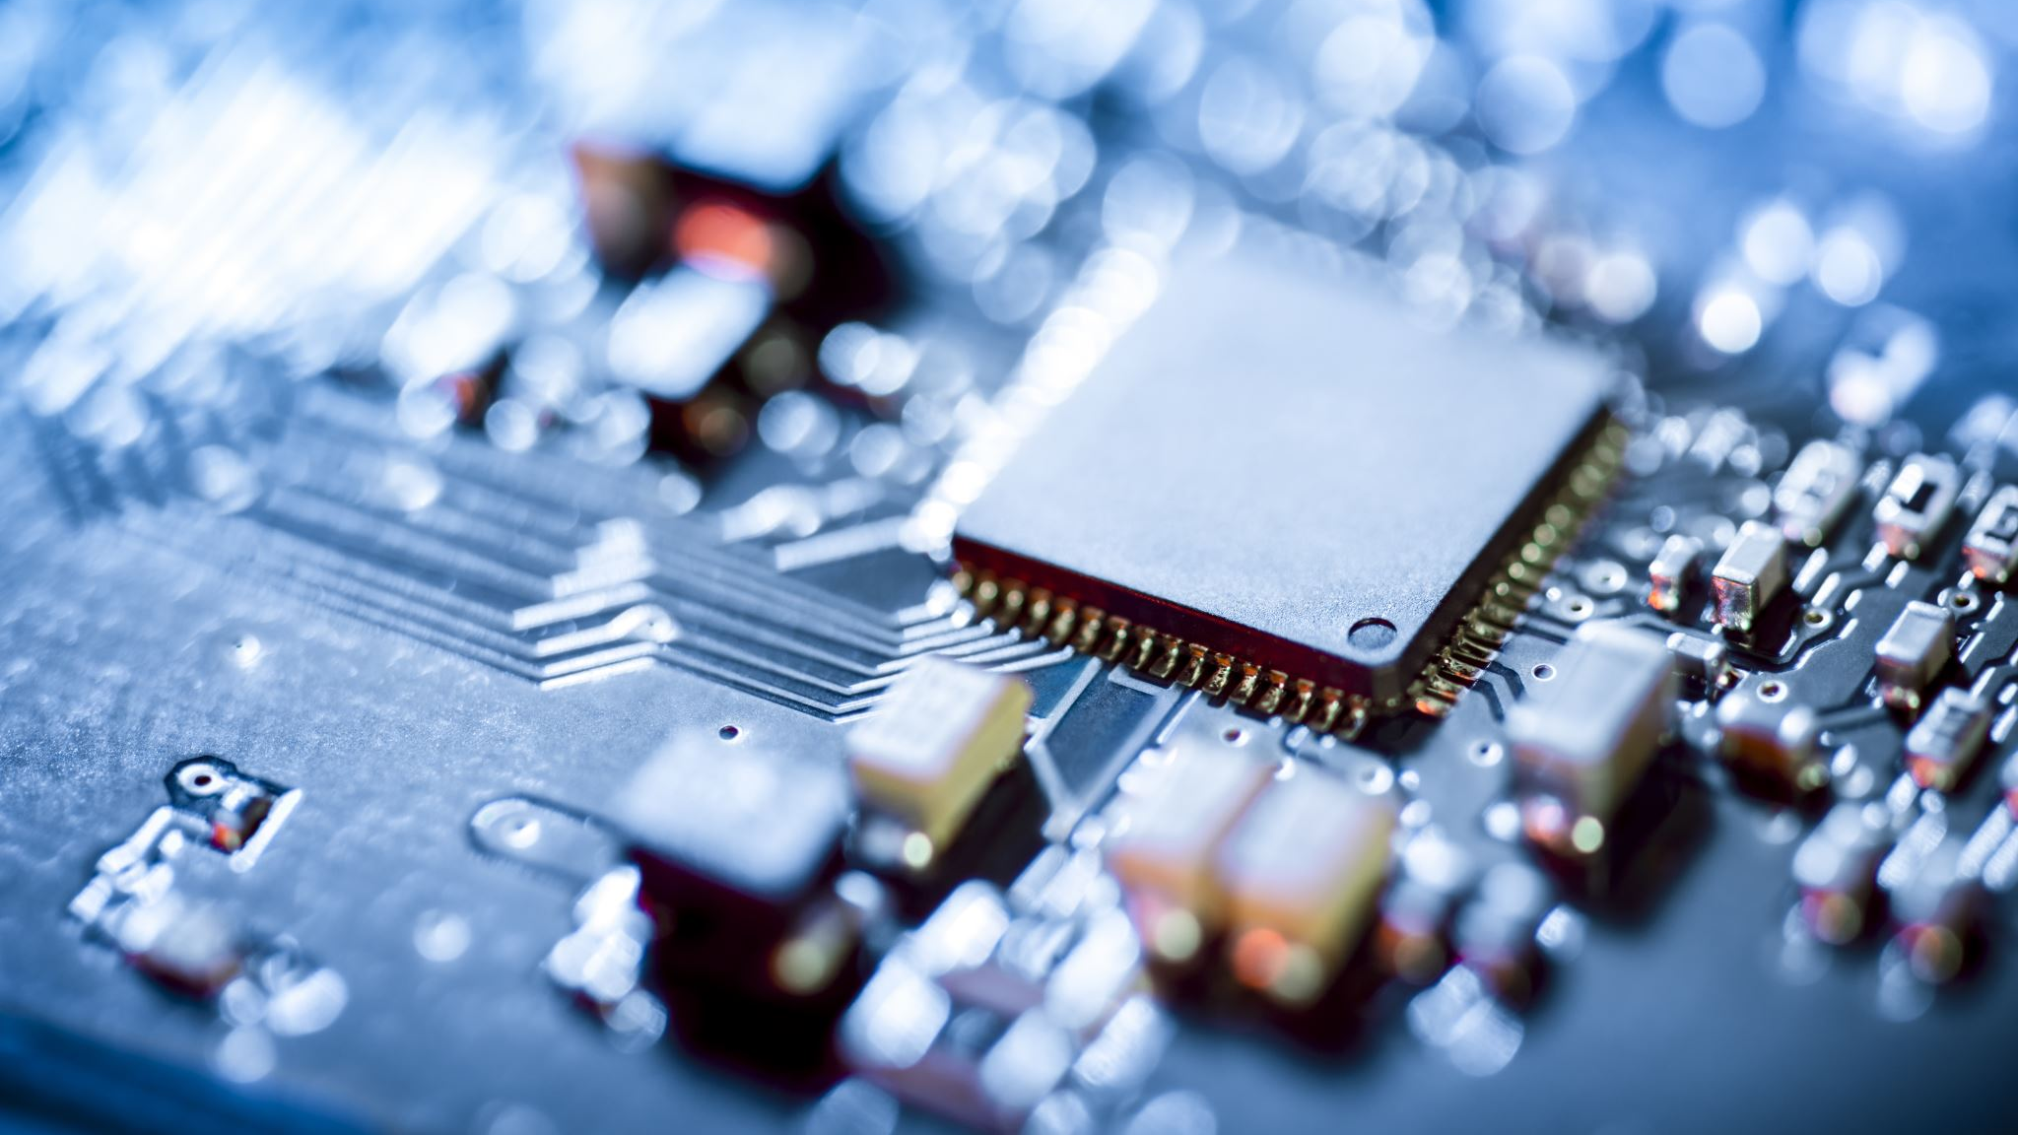
INVENTORY OF PARTS,
CIRCUIT BUILDING,
AND DISPLAYING MESSAGES

Slide 7
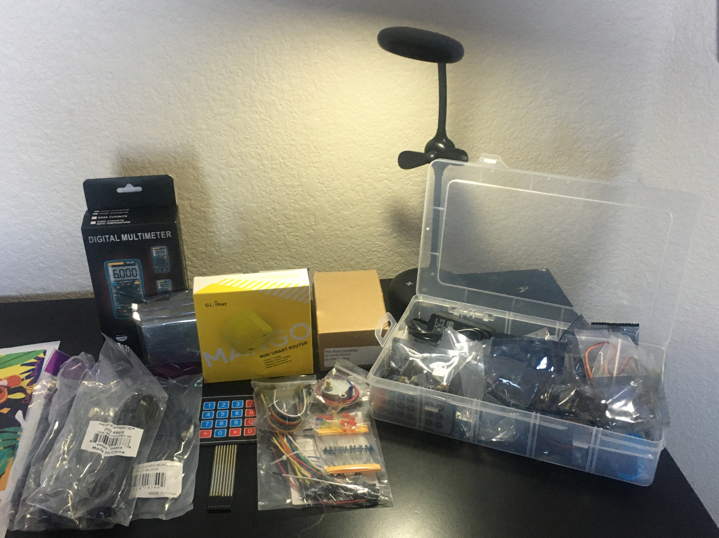
INVENTORY OF ULTRASONICS IoT KIT (PICTURE)
UCTRONICS Kit
ESP32 (2)
LCD Modules (2)
Breadboards (3)
Mini Router
Patch Cable
Digital Multi Meter
USB to Micro USB (2)

Slide 8
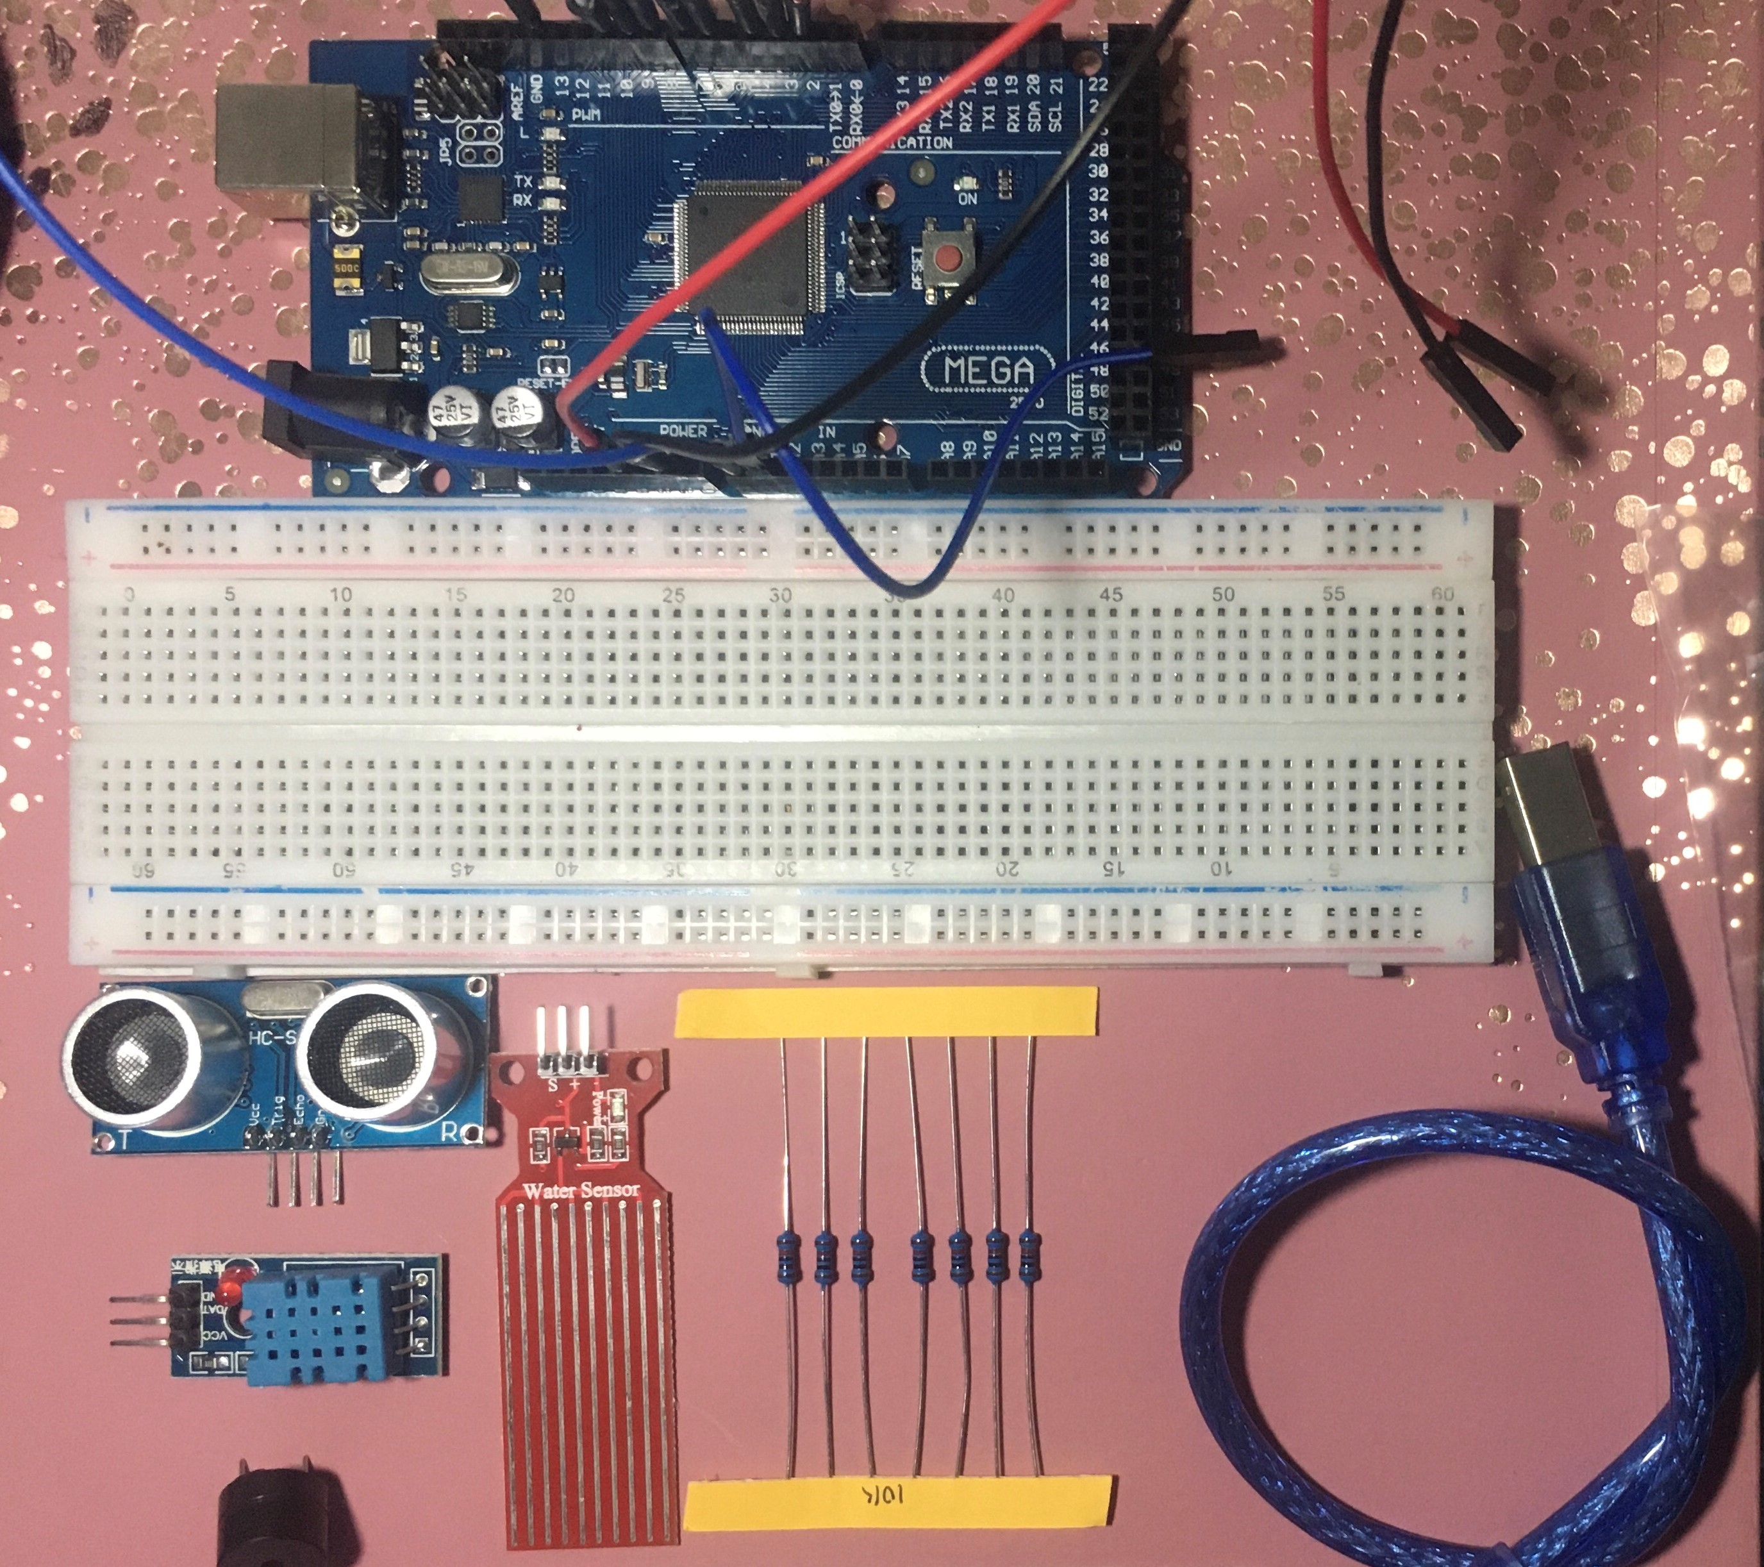
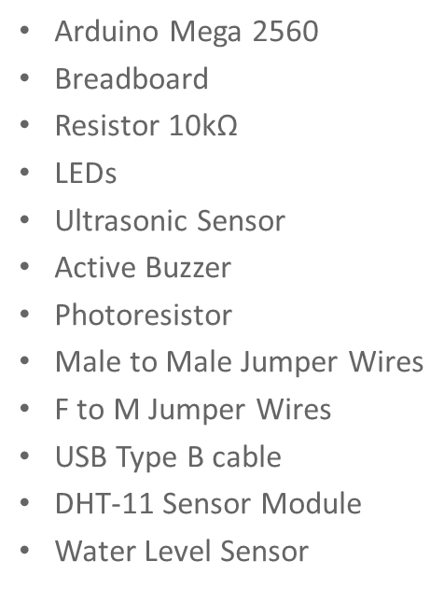
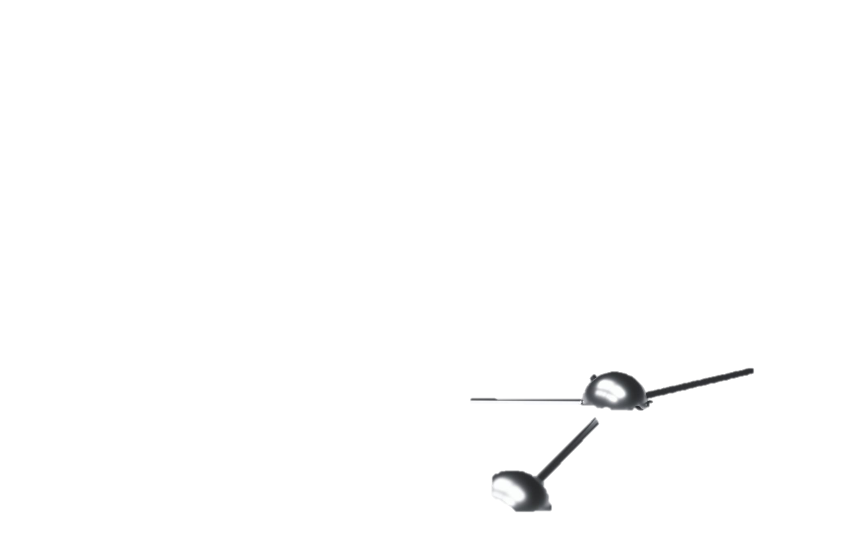
ORGANIZATION OF PROJECT COMPONENTS

Slide 9
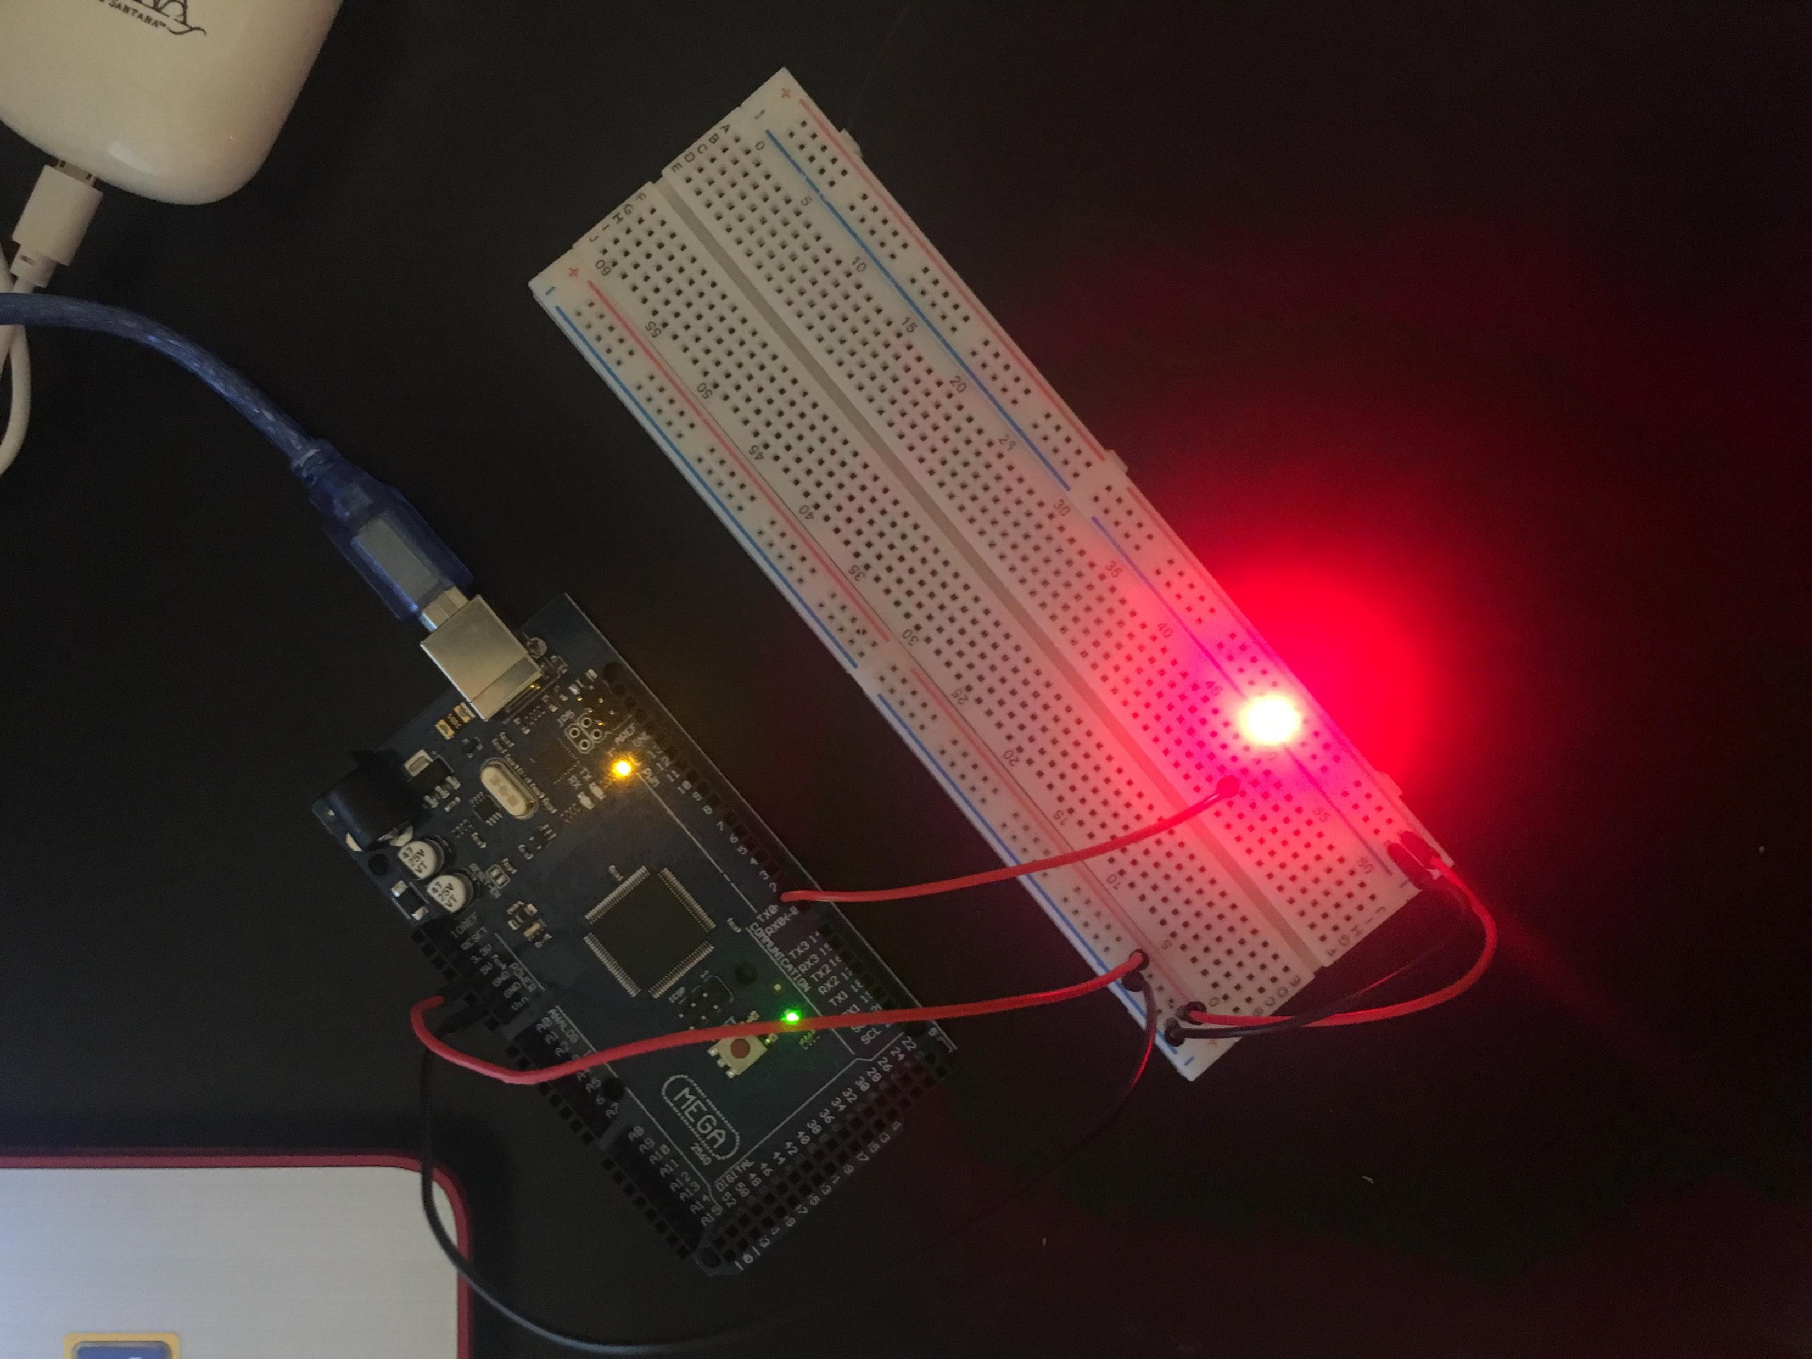
CIRCUIT WITH RED LED ON (PICTURE)

Slide 10
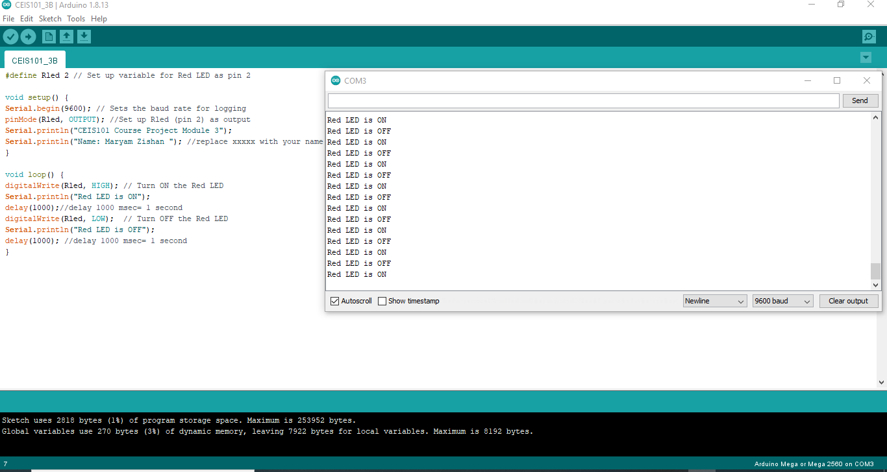
SERIAL MONITOR (SCREENSHOT)

Slide 11
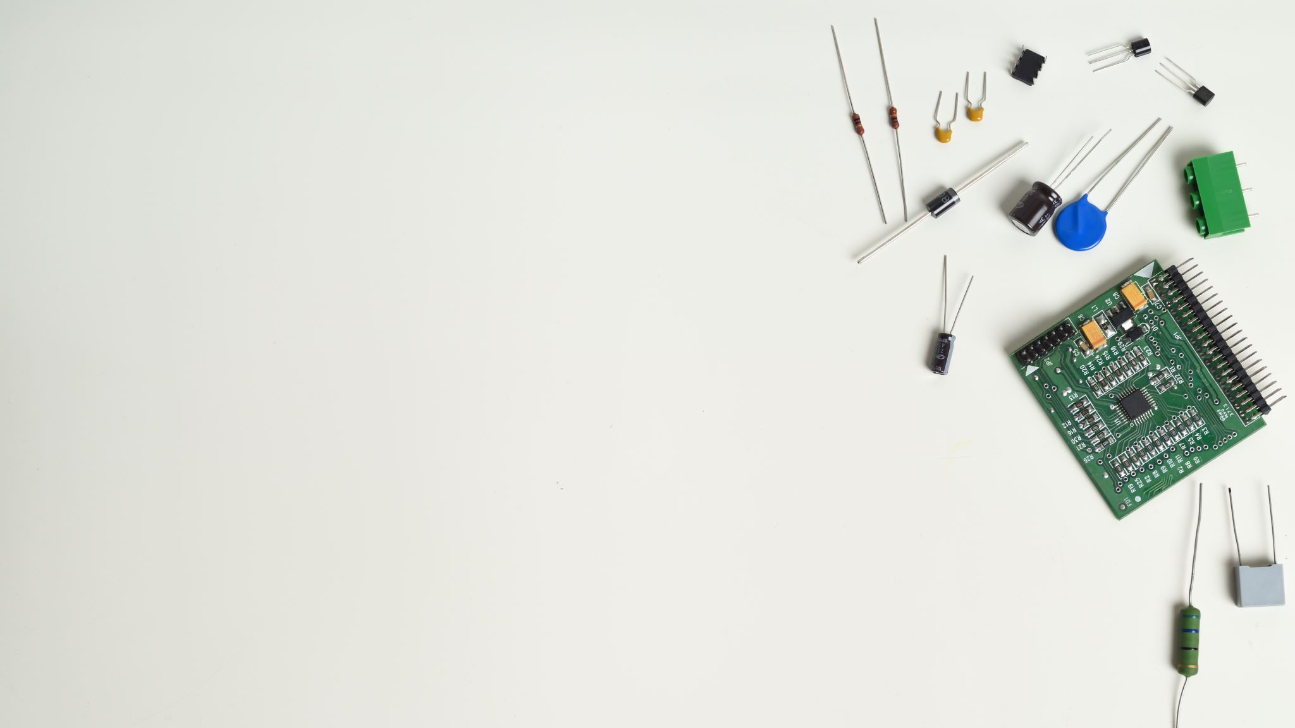
ADDING DOOR SENSOR TO THE SMART HOME SYSTEM

Slide 12
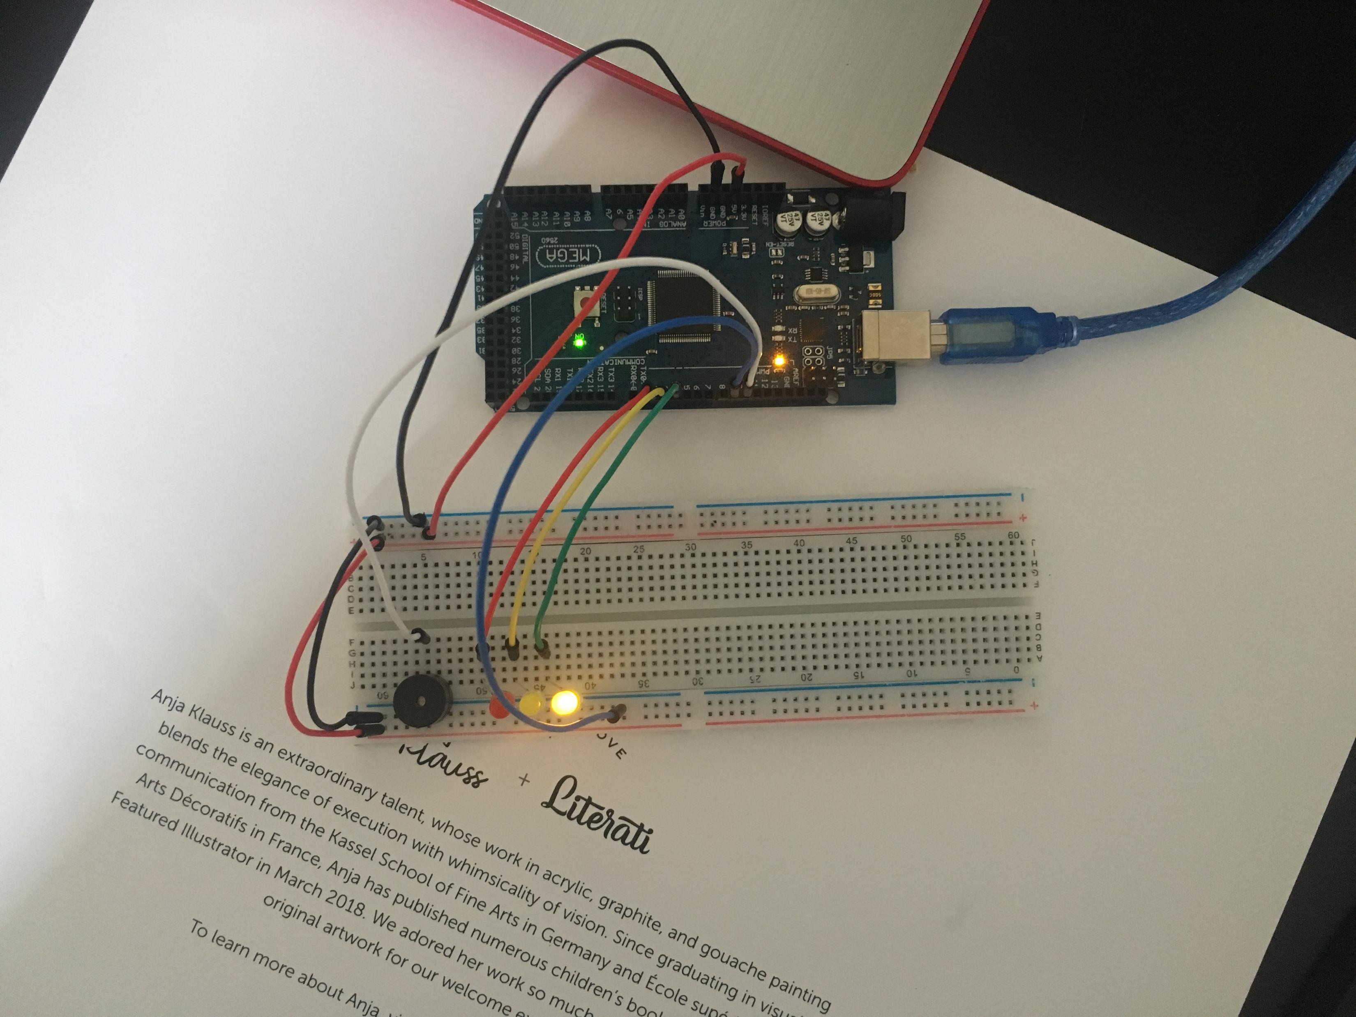
CIRCUIT OF DOOR CLOSED WITH GREEN LED ON (PICTURE)

Slide 13
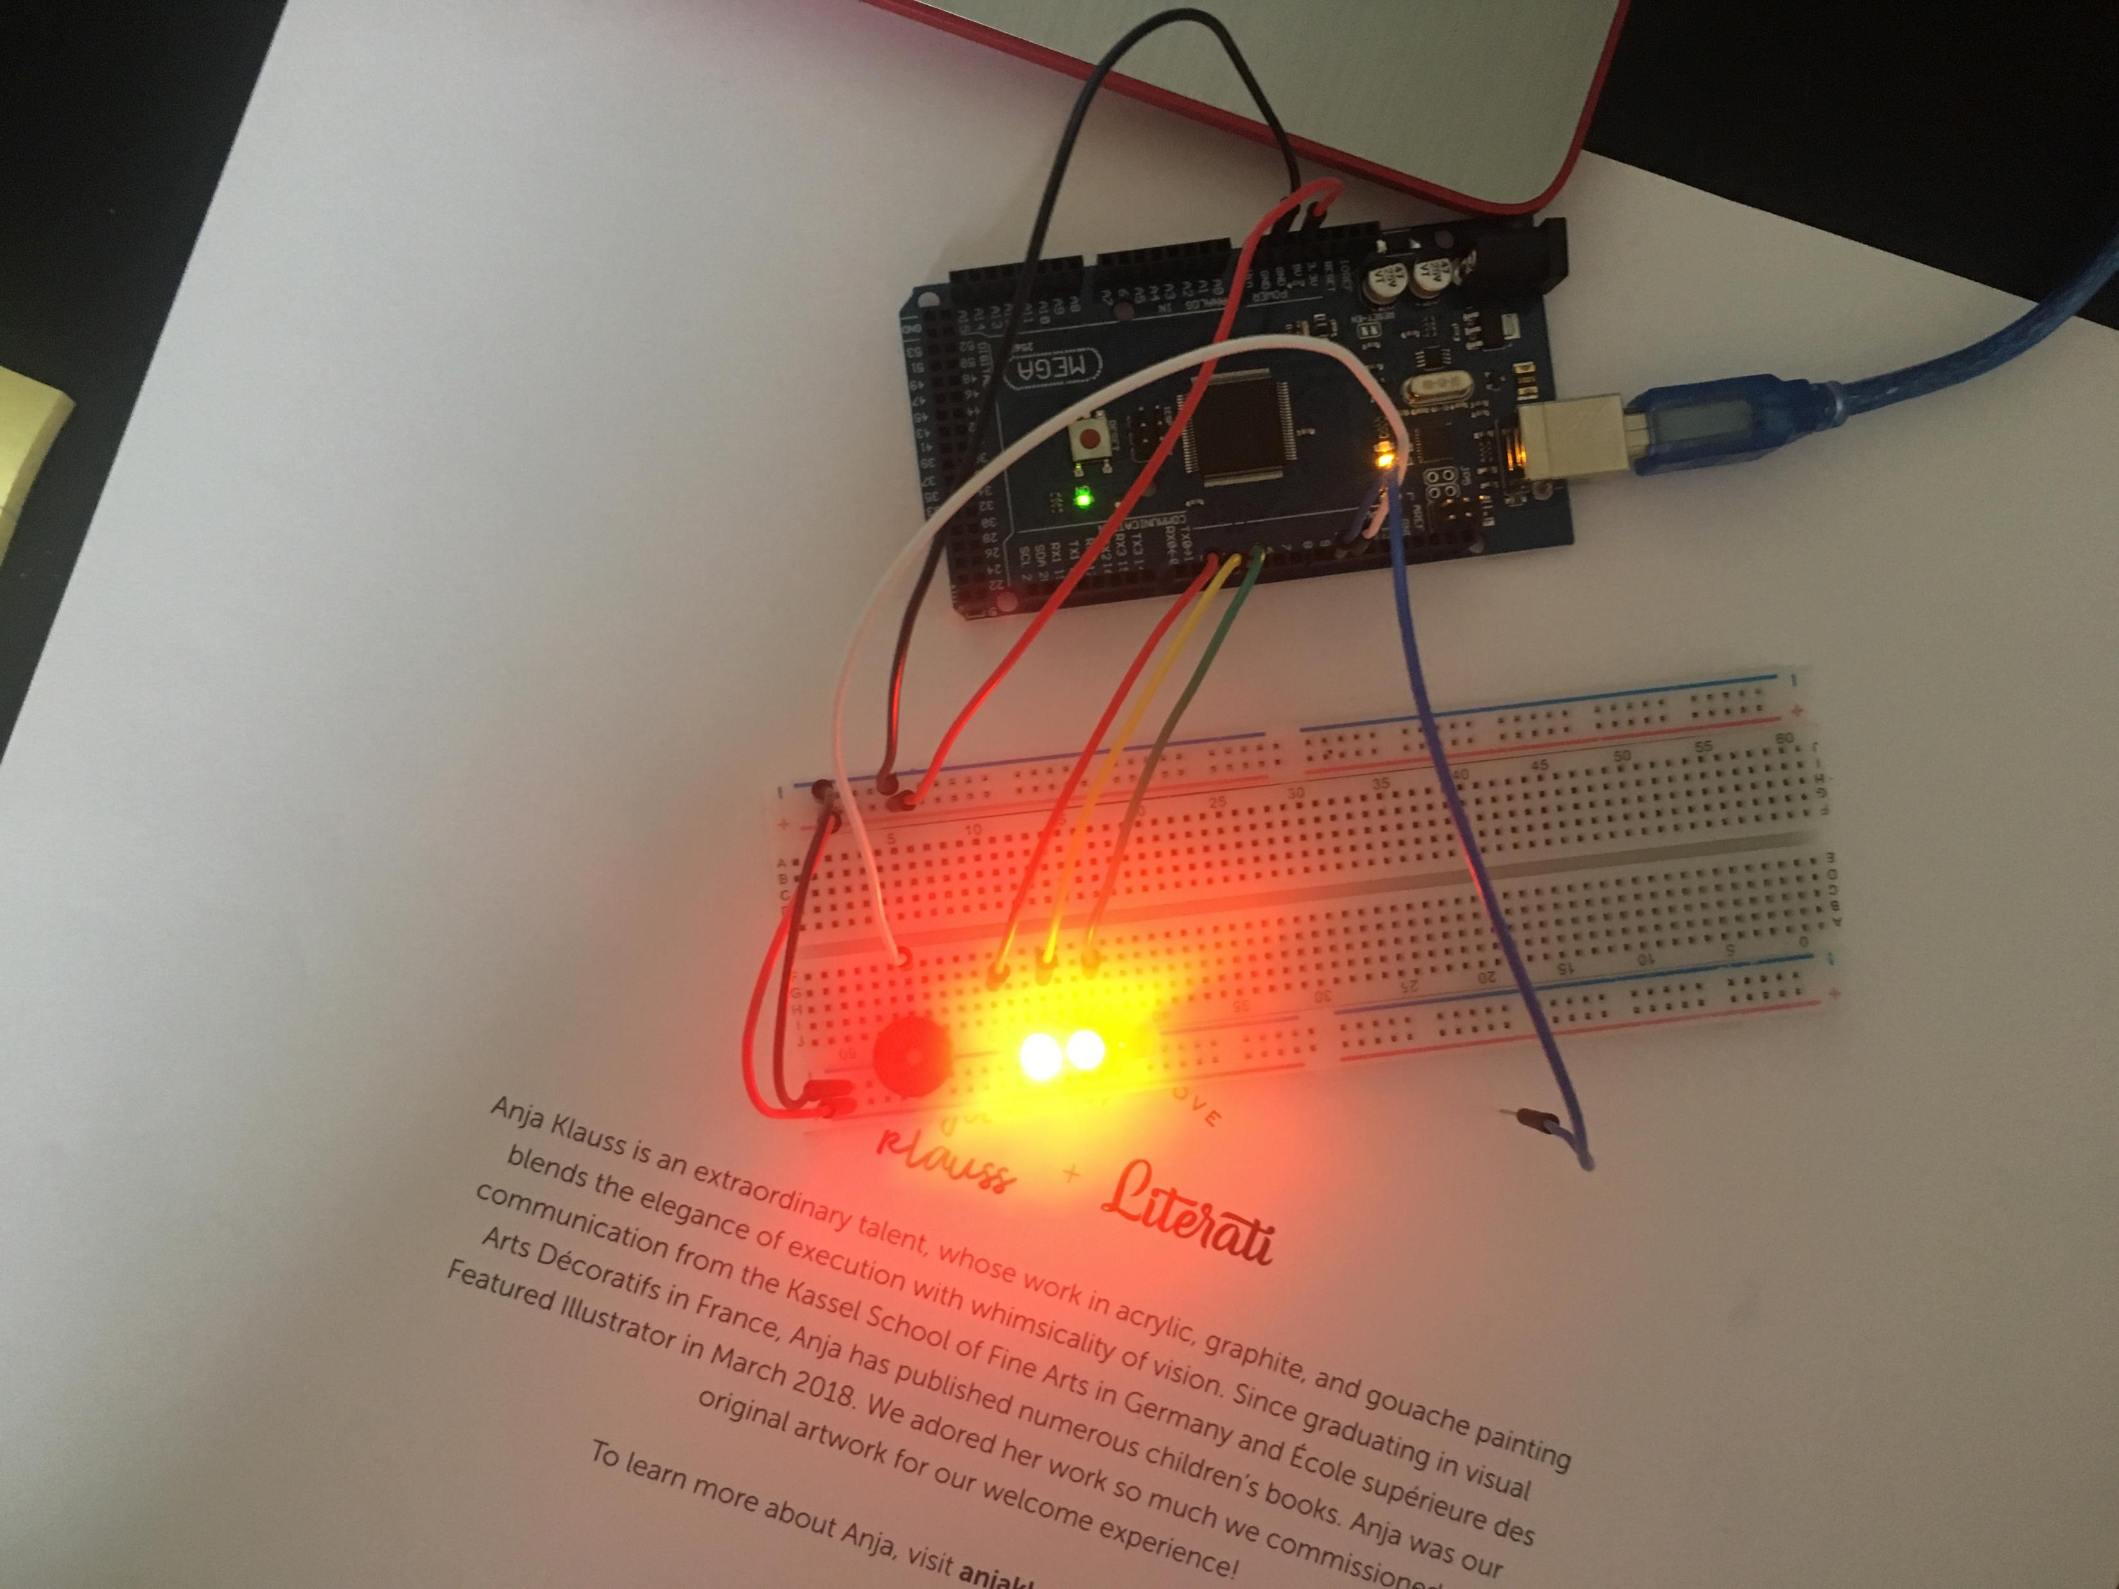
CIRCUIT OF DOOR OPEN WITH GREEN LED OFF (PICTURE)

Slide 14
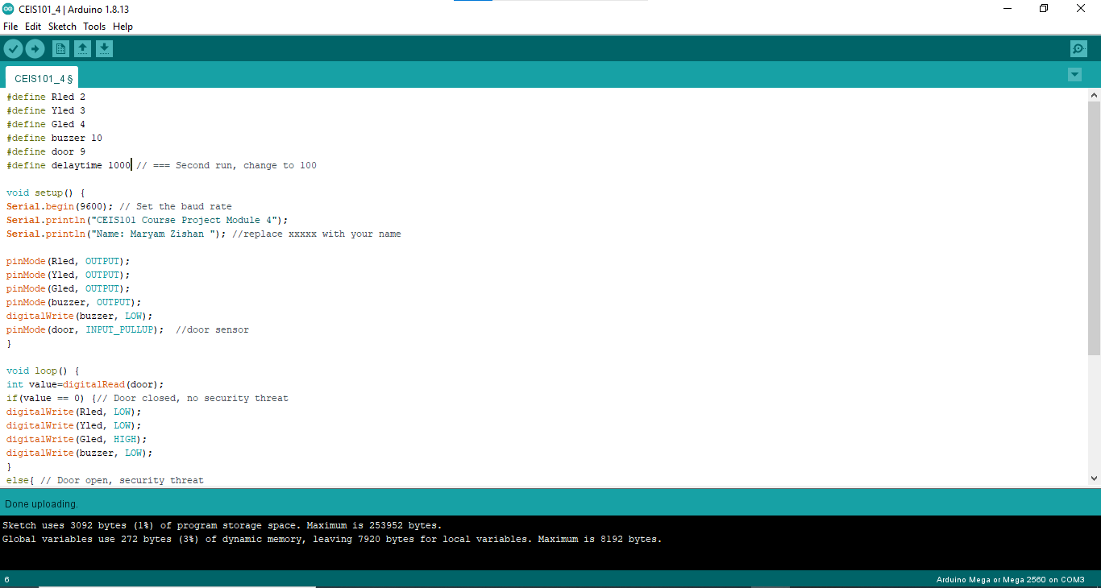
CODE (SCREENSHOT)

Slide 15
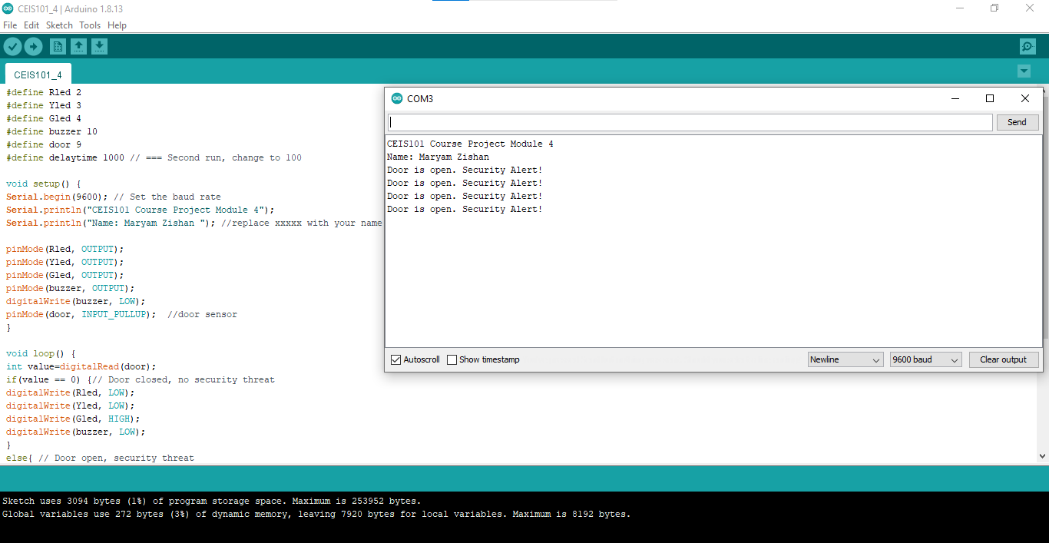
SERIAL MONITOR (SCREENSHOT)

Slide 16

Adding Distance Sensor to Smart Home System and Conducting Data Analysis

Slide 17
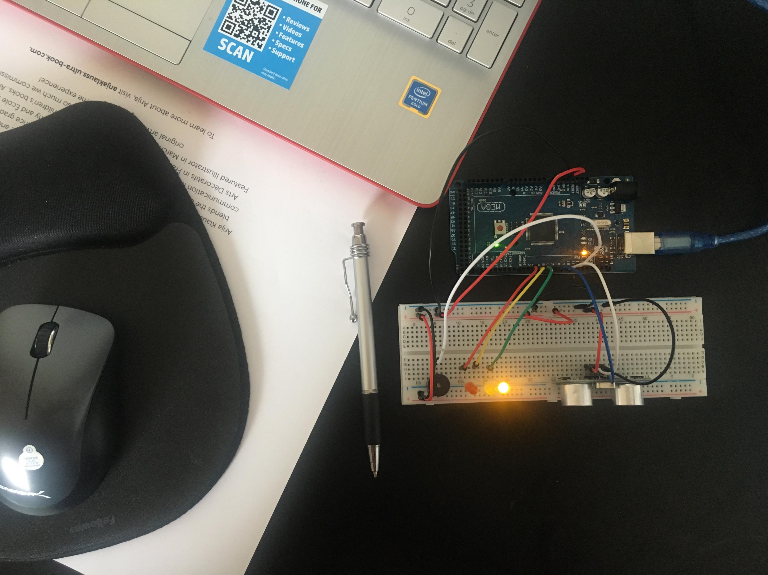
CIRCUIT WITH GREEN LED ON (PICTURE)

Slide 18
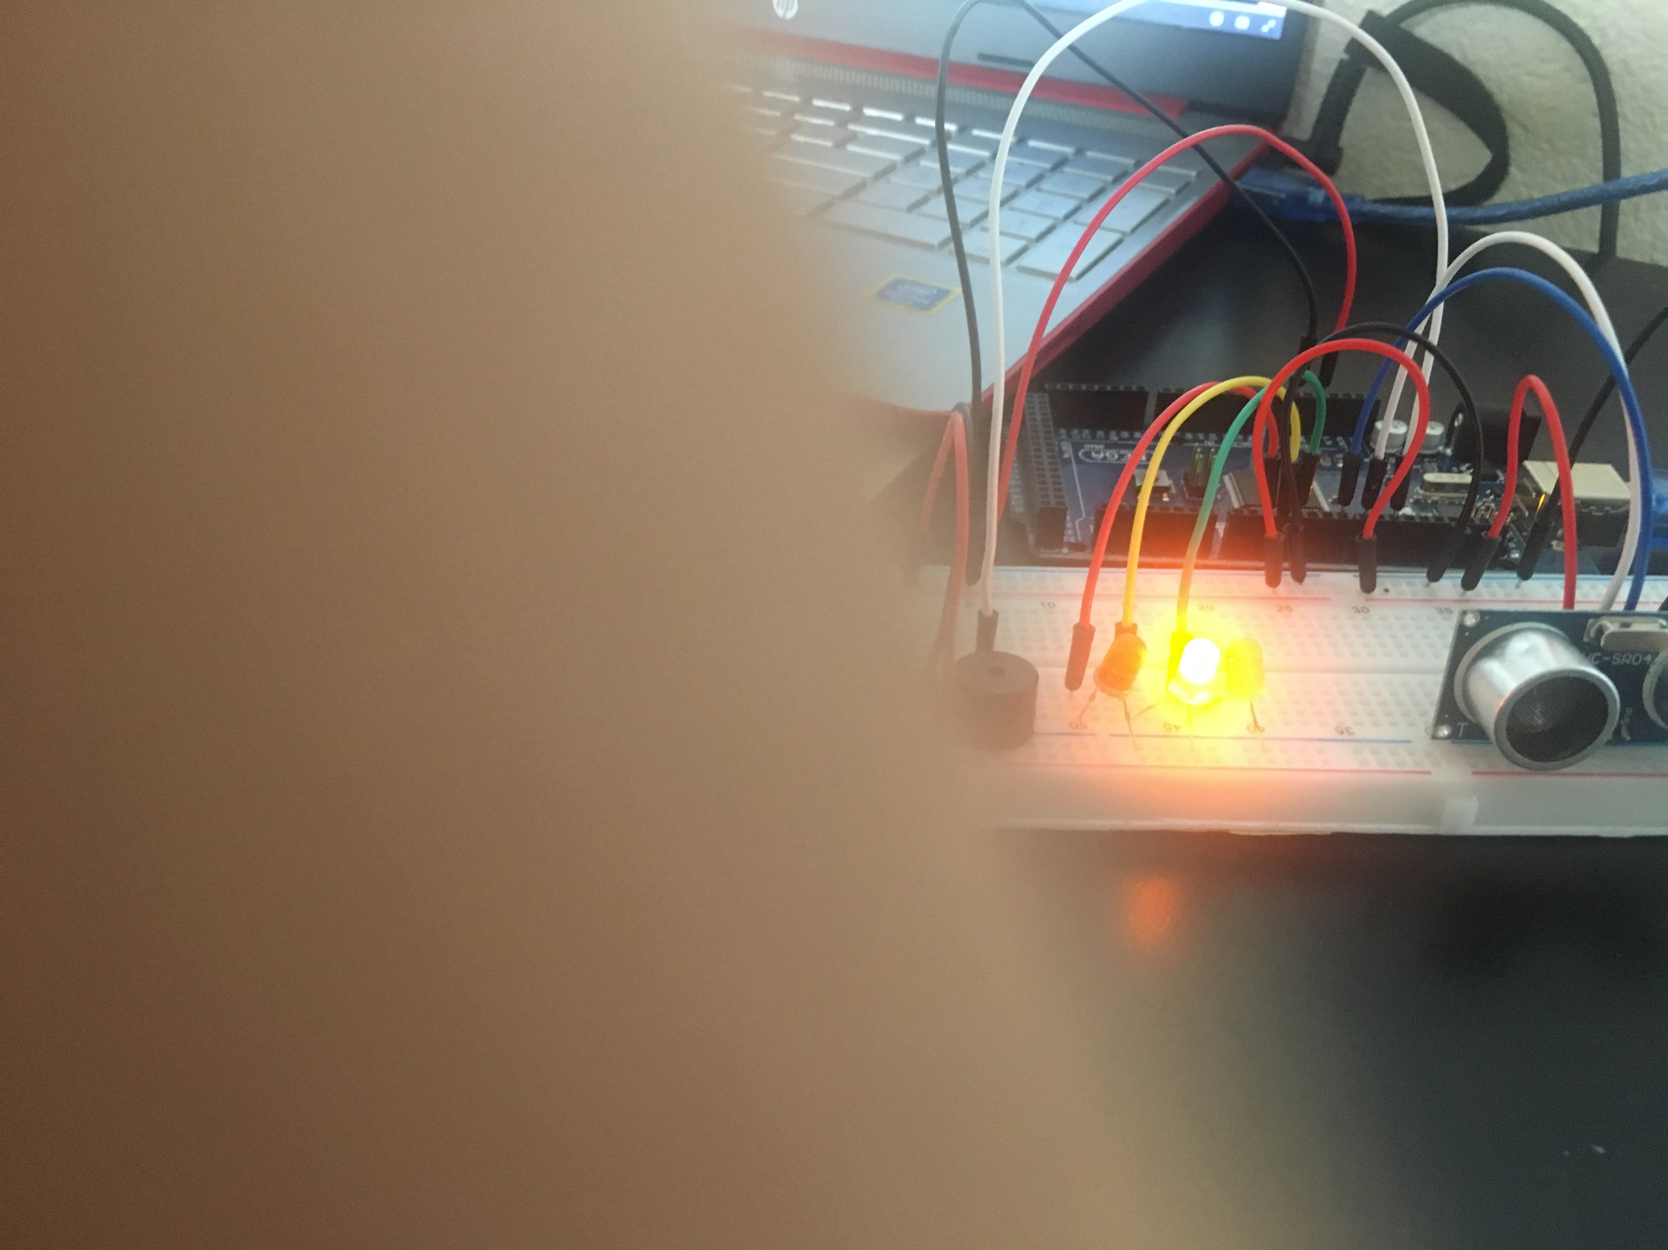
CIRCUIT WITH YELLOW LED ON (PICTURE)

Slide 19
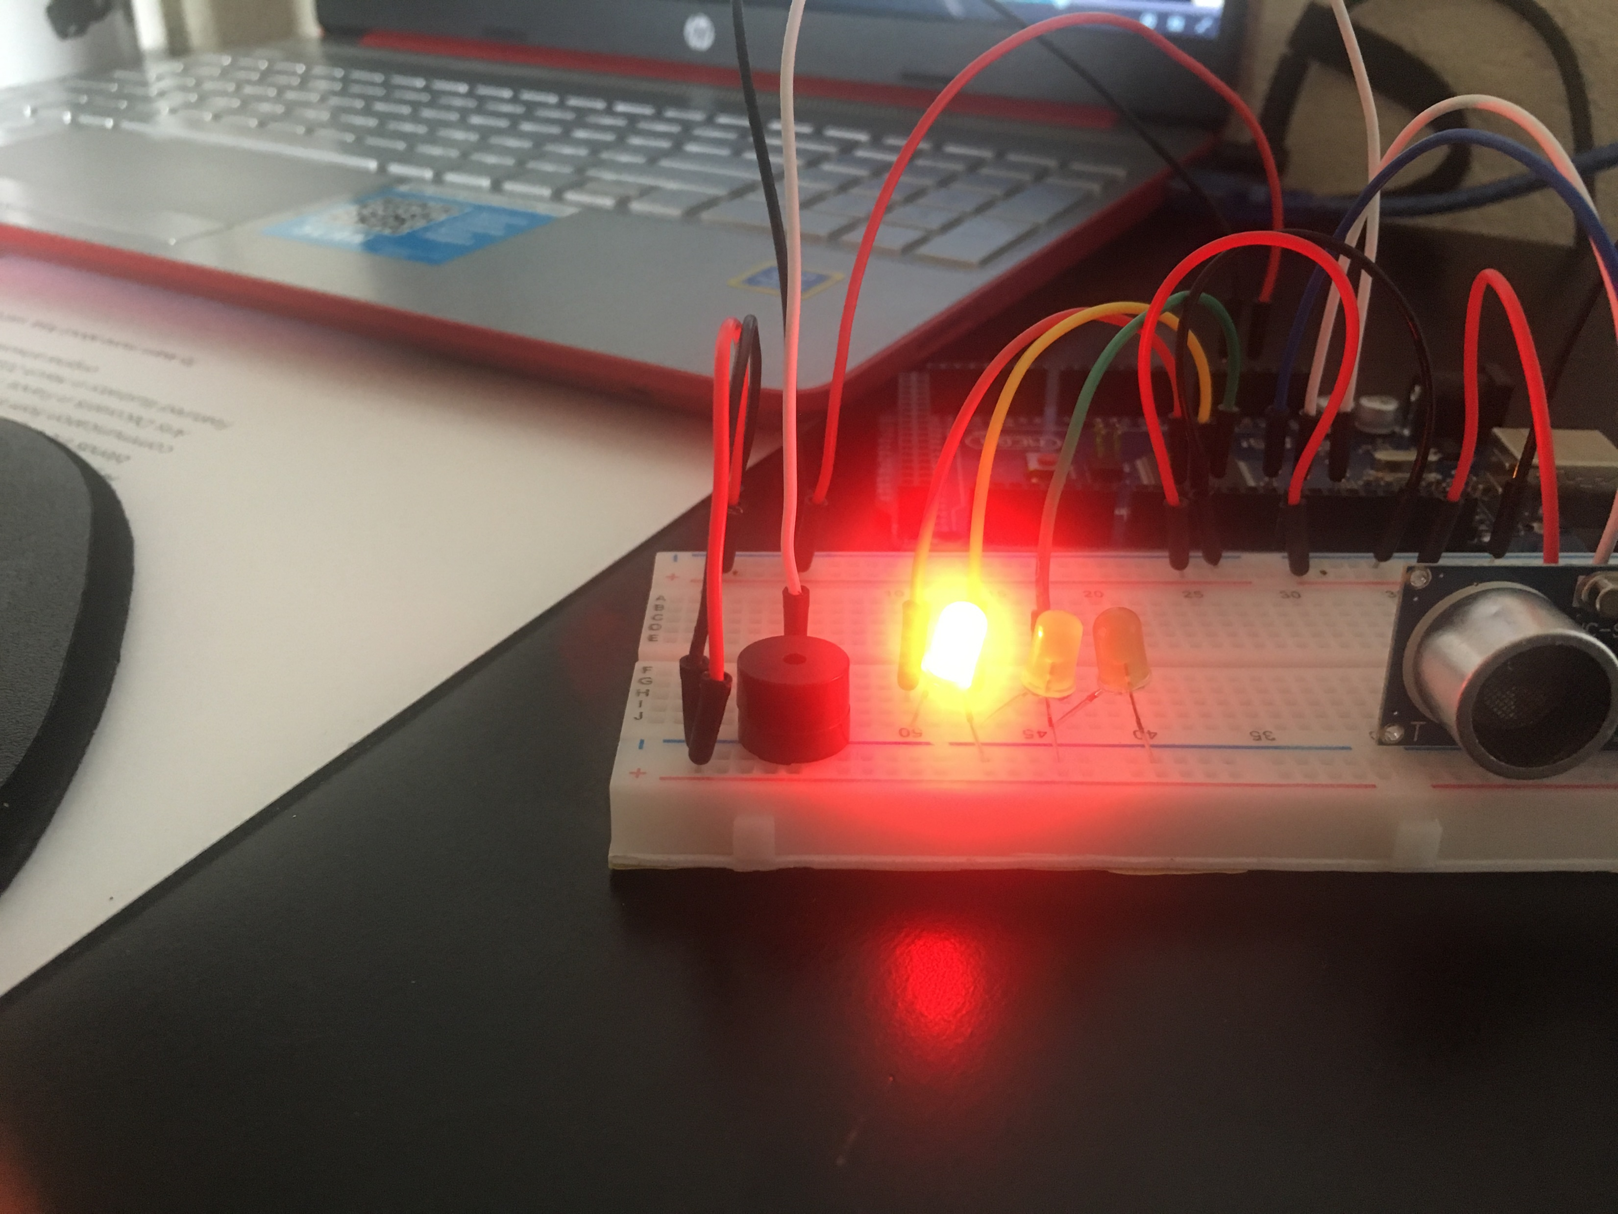
CIRCUIT WITH RED LED ON (PICTURE)

Slide 20
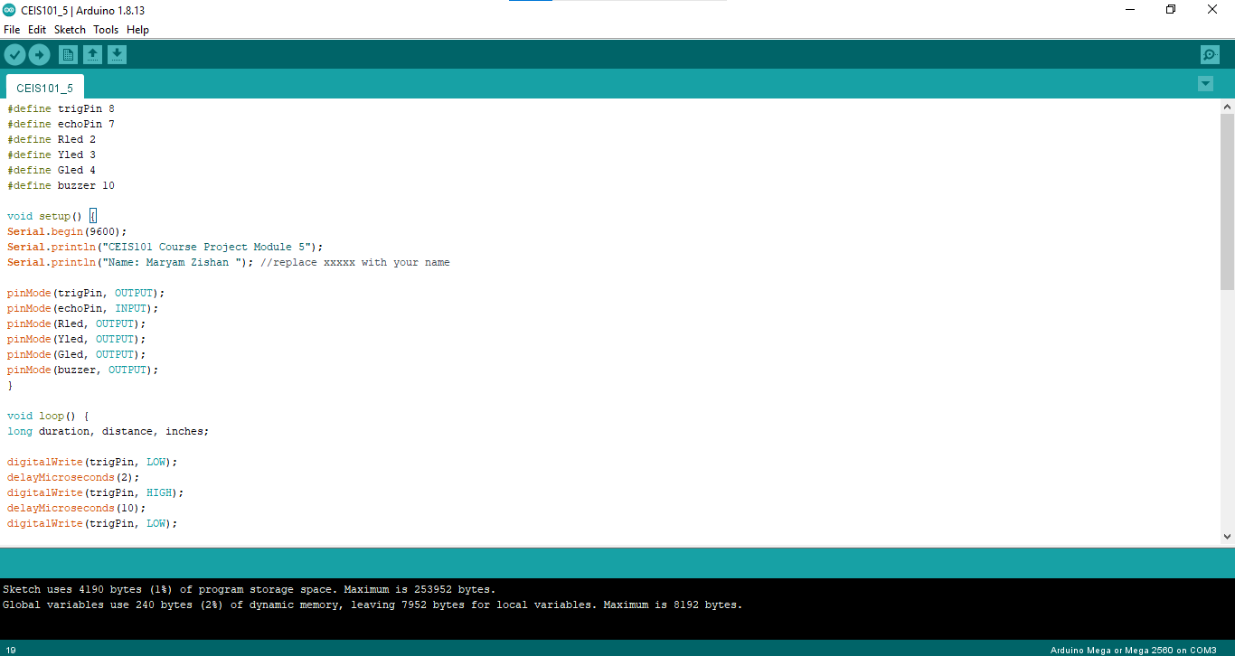
CODE (SCREENSHOT)

Slide 21

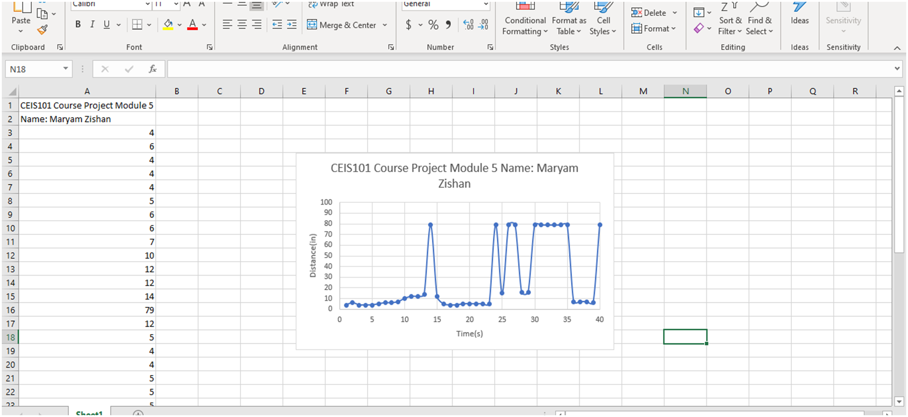
PLOT OF DATA (GRAPH FROM EXCEL)

Slide 22

ADDING AUTOMATED LIGHT TO SMART HOME SYSTEM

Slide 23
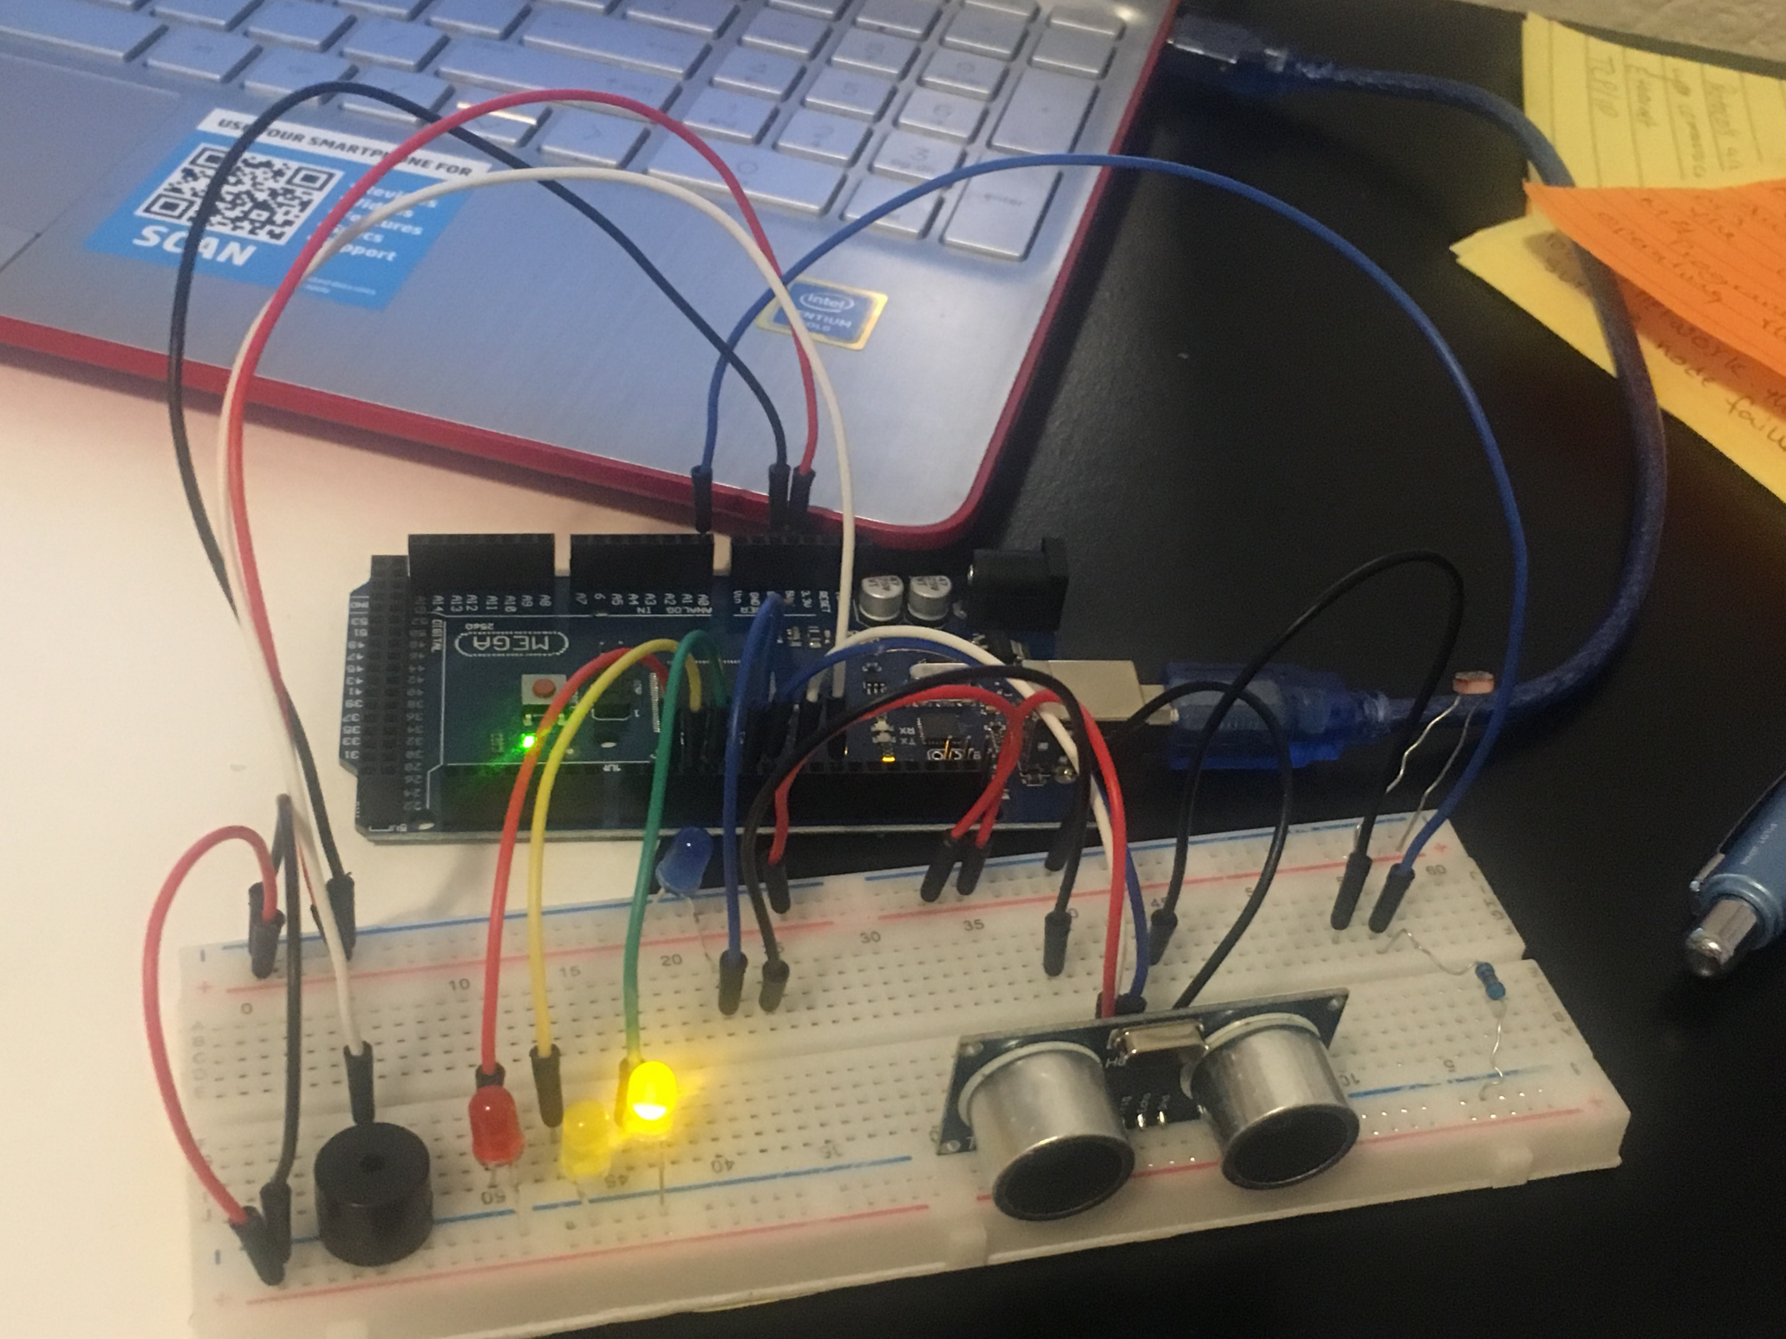
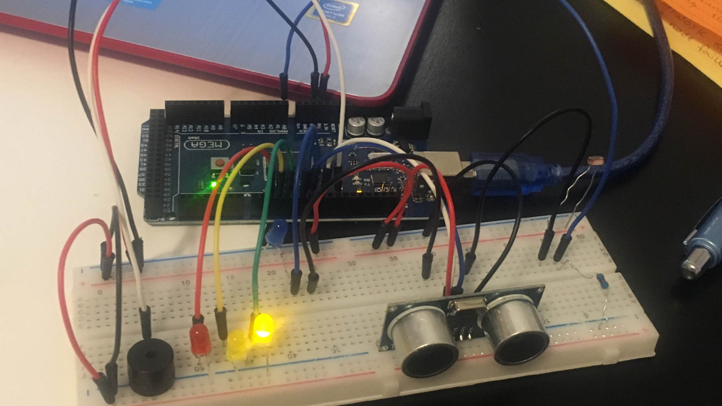
CIRCUIT AUTOMATED LED OFF (PICTURE)

Slide 24
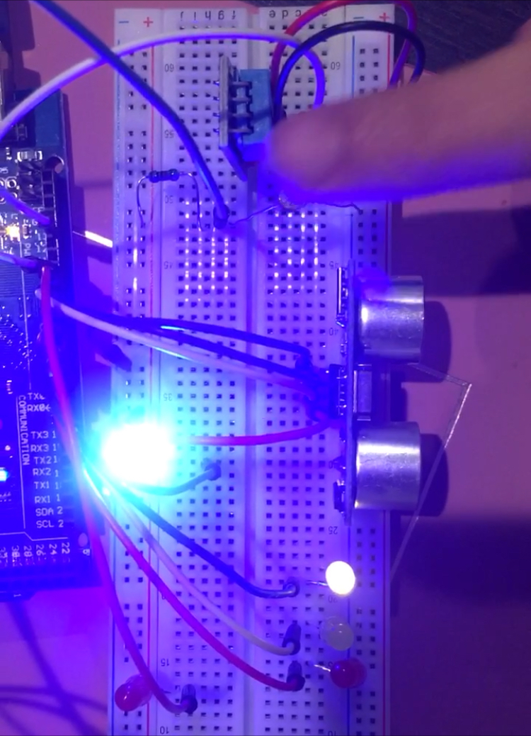
CIRCUIT WITH AUTOMATED LED ON (PICTURE)

Slide 25
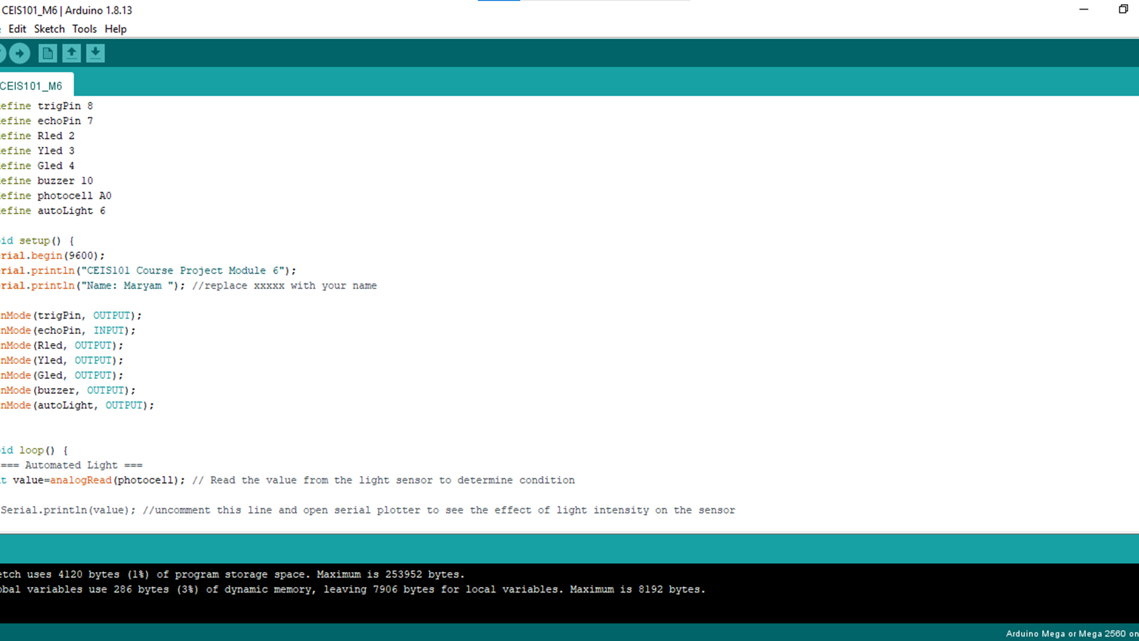
CODE (SCREENSHOT)

Slide 26
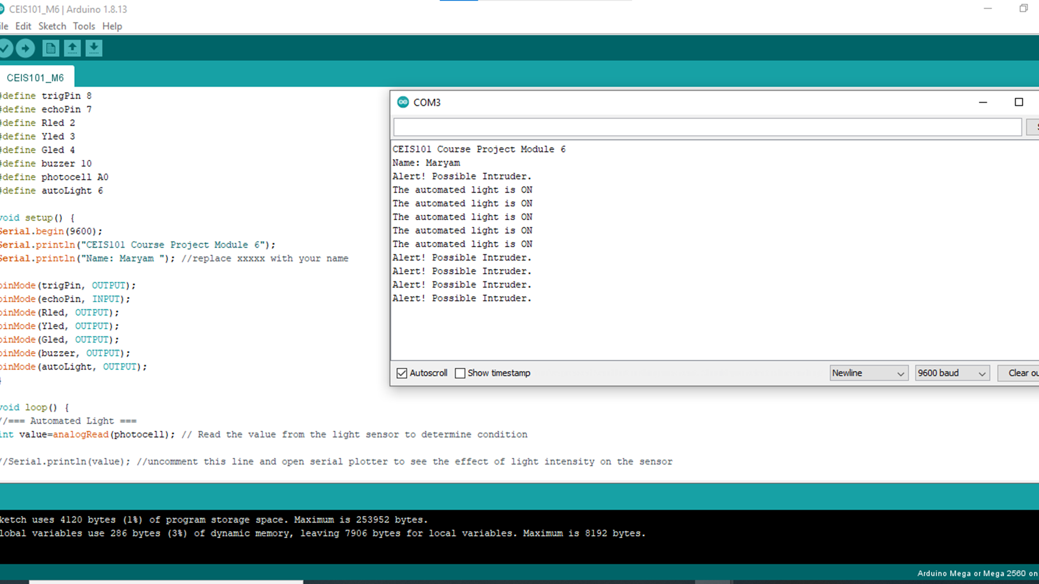
SERIAL MONITOR (SCREENSHOT)

Slide 27

ADDING WATER LEVEL SENSOR AND DHT-11 TO SMART HOME SECURITY SYSTEM

Slide 28
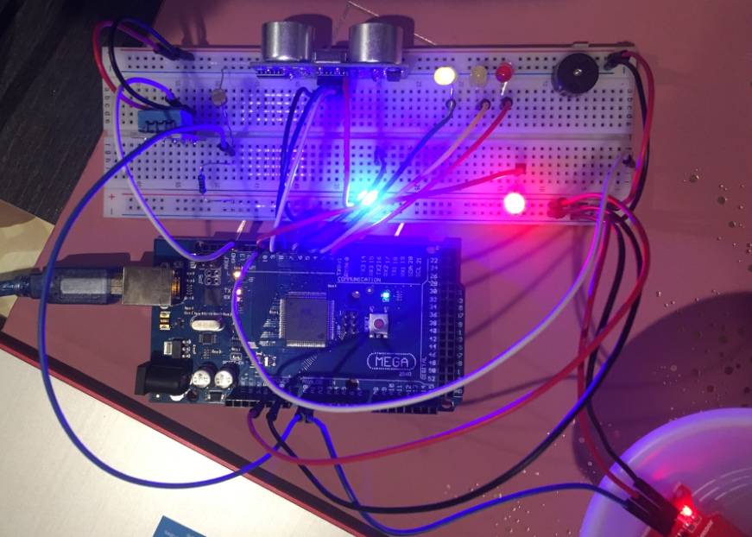
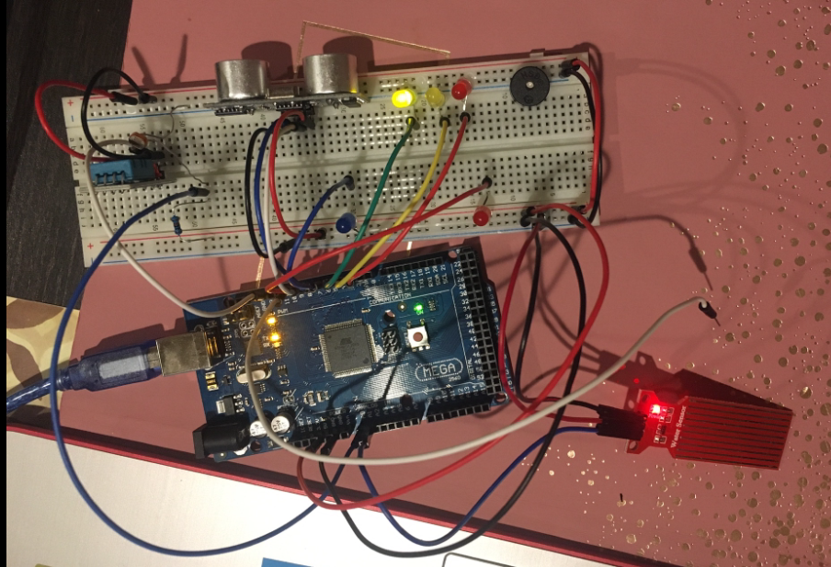
CIRCUIT (PICTURE)

Slide 29
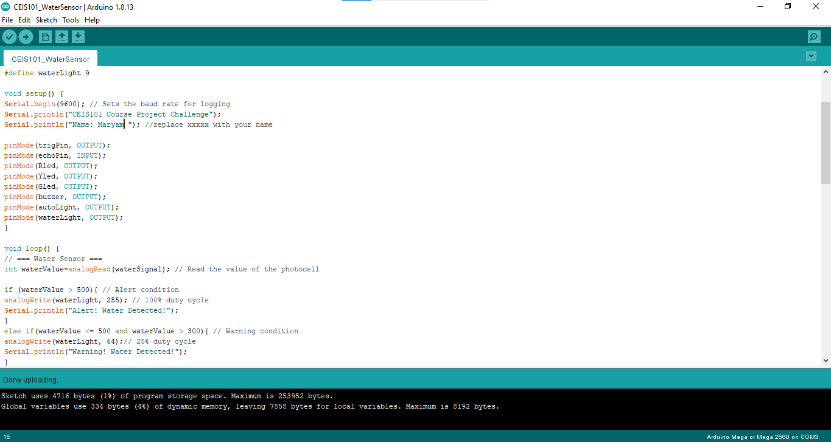
CODE (SCREENSHOT)

Slide 30
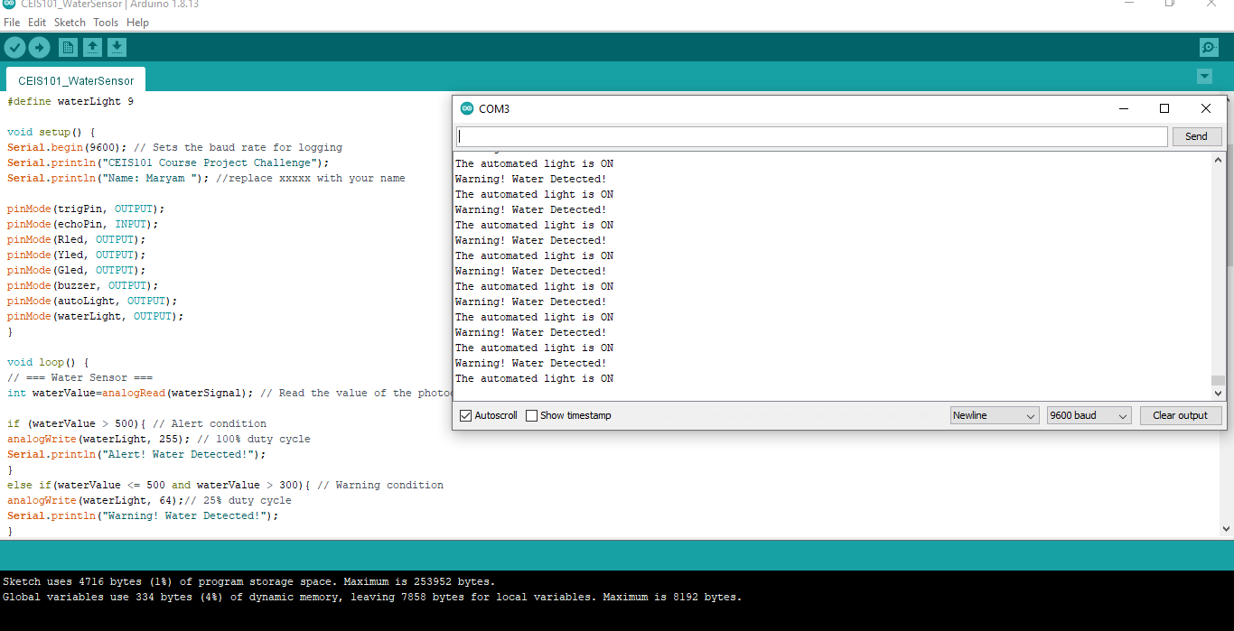
SERIAL MONITOR (SCREENSHOT)

Slide 31
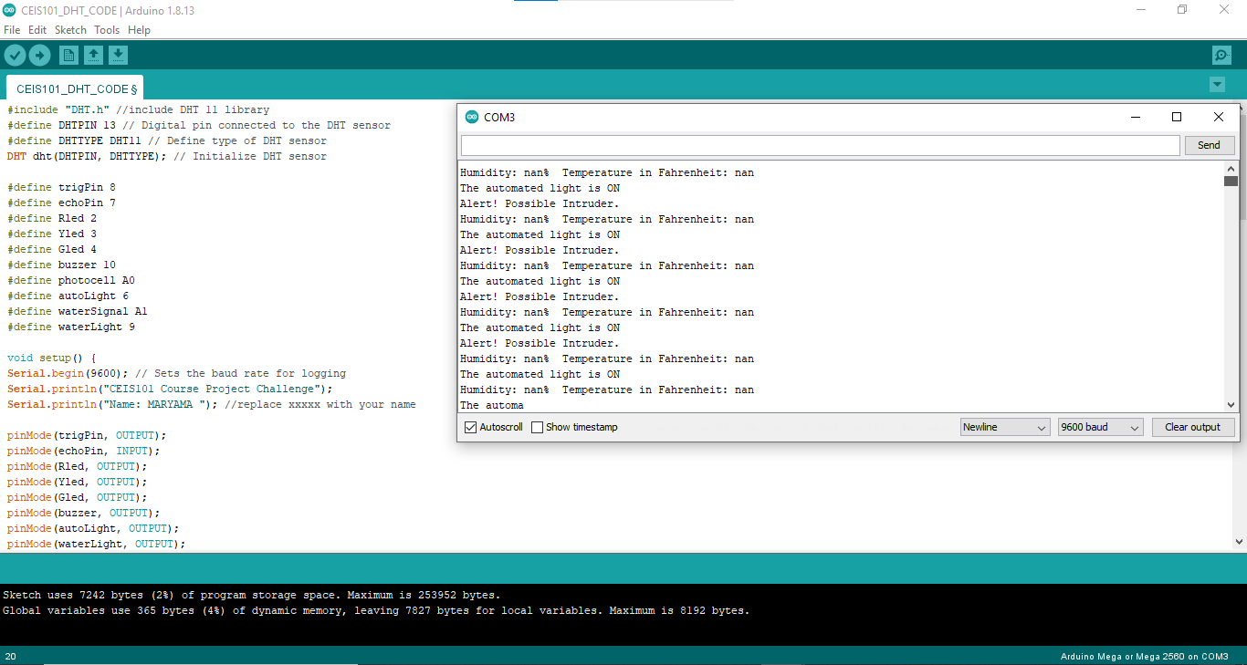
DHT-11 SERIAL MONITOR (SNAPSHOT)

Slide 32
CHALLENGES
Below is the list of challenges that I had to face during this project:
The LED won’t turn on.
Reading pin numbers on board could be quite challenging
Sometimes I would miss to copy the last lines of the code

Slide 33
CAREER SKILLS ACQUIRED
Basic skills that I acquired through this project are listed below:
Basic understanding of Hardware and Software
Network connectivity and Devices
Code/ programming
Importance of Security and it’s knowledge at basic level
Facts on IoT
Business Analytics and Fundaments of Operating System
Learned about P2D2

Slide 34
CONCLUSION
Almost 30 billion or more devices are expected to be working by the ear 2020. Hence, the increase in the demand of Internet Of Things is obvious. Increase in the demand of IoT devices is directly proportional to increase in IT jobs.
With basic understanding of Arduino Mega Board and it’s component I feel more confident about my future in the world of IT.
Hopefully, this will give me some confidence in terms of how devices are created to benefit people in the best way possible.

