Slide 1
CEIS 191
FINAL COURSE PROJECT fundamentals of information technology and networking
PRESENTED BY: MARYAM ZISHAN

Slide 2
Introduction
This PowerPoint Demonstrates a detailed Summary of knowledge I gained over 8 weeks in Ceis191 Fundamentals of Information and Network Technology at DeVry University under the directions of Professor Peter Bieniek. Basically, we covered topics such as cloud computing, IP addressing, network security, the OSI model, and wireless .networks.
The project covers the fundamentals of networking that plays a vital role in the world of IoT. The design and development process of building a network includes SOHO router configurations, subnetting, connectivity testing, network documentation, and SOHO wireless network security.

Slide 3
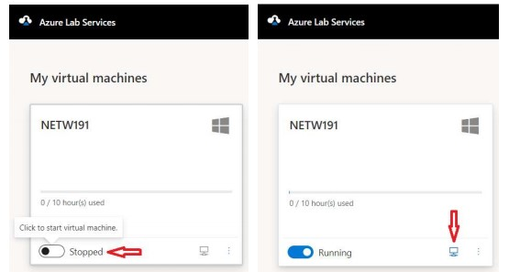
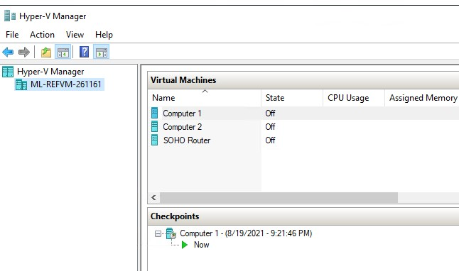
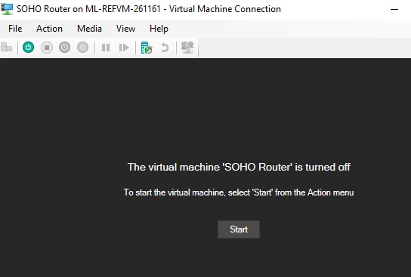
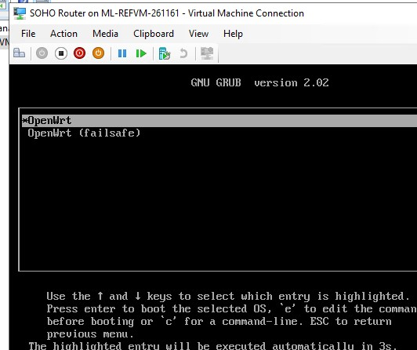
Screenshot of Installed Linux’s COMPUTER1, COMPUTER 2 AND SOHO VM downloaded from software called VMware workstation through Azure Lab service

Slide 4
Module 2
IPv4 Addressing

Slide 5
How to assign an IPv4 address to the SOHO Router virtual machine
Preparation:
Start SOHO router VM and Computer 1
On comp1 open terminal by right clicking on the desktop and type ip route | grep default. Then press enter.
The default IP address of the SOHO Router LAN interface is 192.168.1.1. This value is provided to the Computer 1 VM as the “default gateway” parameter during the DHCP negotiation process.
On the SOHO Router VM, press the Enter key a couple of times to receive a command prompt. Type the passwd root command and enter password twice to set the root password.
Router Management Interface
On the Computer 1 VM, open the Firefox browser. Enter 192.168.1.1 in the browser address bar to access the management interface of the SOHO Router. On the Authorization Required page, enter the root password (i.e., password) and click Login
On the top menu bar, select Interfaces from the Network drop-down menu to view the interfaces of the SOHO router
IPv4 Address Assignment:
On the top menu bar of the SOHO Router, select Interfaces from the Network drop-down menu. Click on the Edit button next to the LAN icon.
Enter 192.168.105.1 in the IPv4 address field and 255.255.255.0 in the IPv4 netmask field.
Click on the Save button in the bottom right corner to save the new IPv4 configurations.
Verify that the Computer 1 VM is now getting a 192.168.105.x IPv4 address by writing commands in Computer 1 VM terminal and reconnected to the management interface of the SOHO Router!

Slide 6
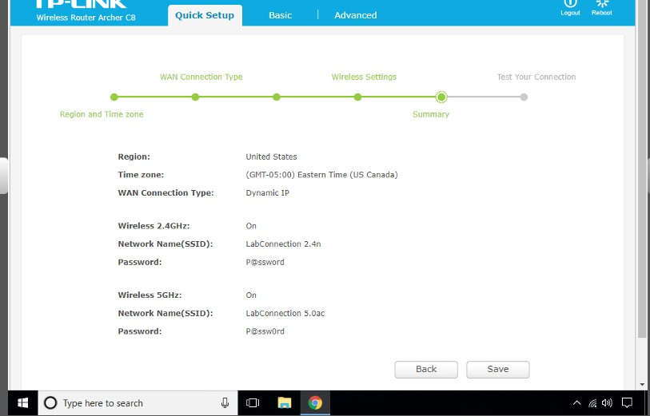
Configuration Program
This screenshot should include the browser window that shows the router IP address in the address box.

Slide 7
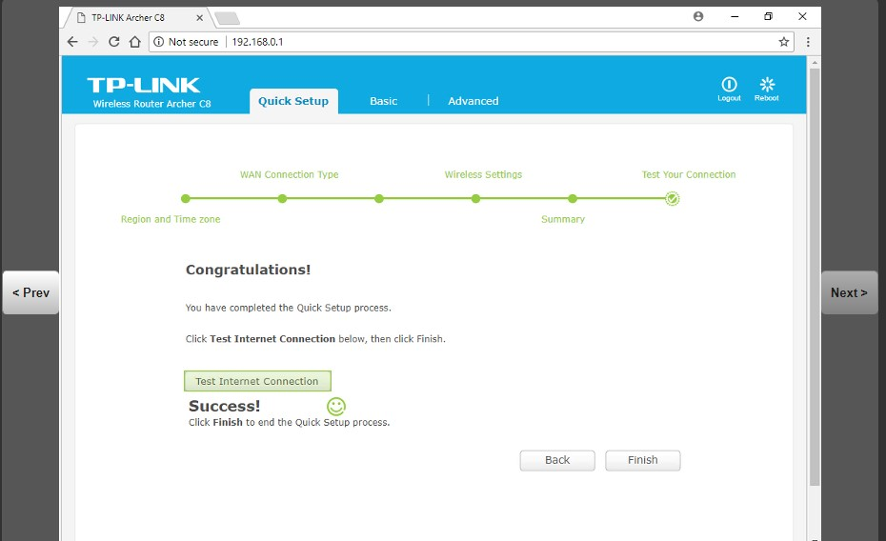
Test Internet Connection
This screenshot should include the “Test Internet Connection” result.

Slide 8
Module 3
Use the Administrator Interface to Modify Router Configuration

Slide 9
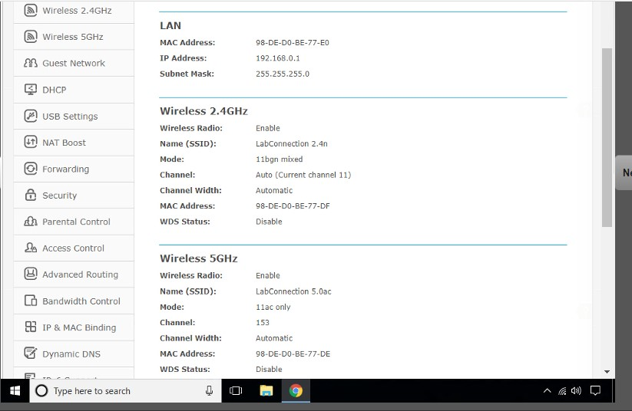
Advanced Settings - LAN
This screenshot should show the LAN IP address on the Advanced Settings page.

Slide 10
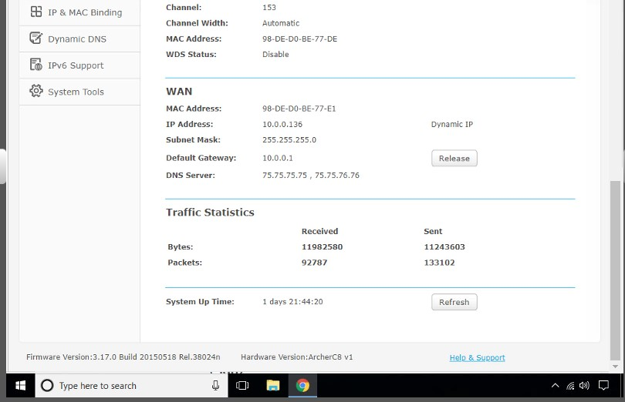
Advanced Settings - WAN
This screenshot should show the WAN IP Address and Default Gateway on the Advanced Settings page.

Slide 11
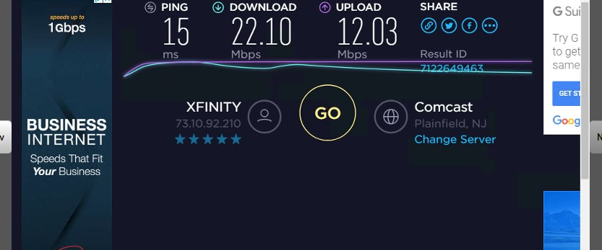
Speed Test
This screenshot should show the speedtest.net test that determines your connection’s capabilities.

Slide 12
Module 4
Design a LAN Using IPv4

Slide 13
Three subnets for the 192.168.100.0/24 network
Network | Number of Devices | Network Address/CIDR | Broadcast Address | Maximum Number of Available Hosts
Public wireless | Average 70 per day | 192.168.100.0/25 | 192.168.100.127 | 126
Patron | 30 | 192.168.100.128/26 | 192.168.100.191 | 62
Staff | 25 | 192.168.100.192/27 | 192.168.100.223 | 30
Network | Number of Devices | Network Address/CIDR | Broadcast Address | Maximum Number of Available Hosts
Public wireless | Average 70 per day
Patron | 30
Staff | 25

Slide 14
IP addresses and subnet masks for the three subnets
Network | First Available Host | Last Available Host | Subnet Mask
Public wireless | 192.168.100.1 | 192.168.100.62 | 255.255.255.192
Patron | 192.168.100.65 | 192.168.100.126 | 255.255.255.192
Staff | 192.168.100.129 | 192.168.100.190 | 255.255.255.192

Slide 15
Module 5
Visio Network Diagram

Slide 16
Microsoft Visio Network Diagram
This diagram should illustrate the interconnection of the Computer 1 VM, the Computer 2 VM, and the SOHO Router VM.

Slide 17
Module 6
SOHO Wireless Network Security

Slide 18
SOHO Wireless Network Security
1. What are the factory default username and password of a TP-Link router? Why is it important to change the default username and password of a SOHO router?
Answer: The default username/password of TP Link routers according to http://routerpasswords.com is admin in lowercase. It is important to change the default username and password of a SOHO router to avoid any unauthorized access to the router and to deter any change in settings of router by an intruder.
2. To protect a SOHO wireless network with a small number of devices, which address management method provides more control, configuring the device IP addresses manually (static IP) or using a DHCP server (dynamic IP)? Why?
Answer: Static IP is the best way to manage a network with small number of devices, it provides more control, you can assign each device it’s own IP Address and even when the device goes offline the IP Address remains assigned to that particular device, each new device to be added to the network will have to assigned an IP Address, Default Gateway, DNS Address etc. manually so static IP provides more control over managing devices on a network.
3. What does MAC filtering do? If needed, when would you use deny filtering rules and when would you use allow filtering rules? What happens to devices that want to connect, if the “Allow the stations specified by any enabled entries in the list to access” function is enabled but there are no entries in the list?***************************************************-**************
Answer: Each network devices whether it is a wireless or wired caries a special serial number known as a MAC address; this address provides us the unique identifier for each device present on the network. Using MAC address filtering on a network we can either stop a device from accessing the network or we can enlist devices which can use the network. We use deny filtering rule if we don’t want a specific device present in the list to connect to the access point. We use allow filtering rule if we want to allow access to devices only listed in the MAC address list. If the “Allow the stations specified by any enabled entries in the list to access” function is enabled but there are no entries in the list no device will be able to connect to the wireless access point since no MAC address entries have been made in the list.

Slide 19
SOHO Wireless Network Security
1.What wireless security settings are displayed on the Wireless Security page? Which one is recommended by the vendor? Why?
Answer: The router page shows 3 different wireless security options, WPA-PSK, WPA2-PSK, WPA3-PSK. WPA2-PSK/WPA3-PSK is recommended by the vendor because it is more modern and robust form of security. WPA2-PSK is the recommended secure method of making sure no one can listen to your wireless data while it's being transmitted back and forth between your router and other devices on your network.
2. Among the configurations you explored in this module, which one is a true security function? Why?
Answer: In this whole guide wireless security is the true security function. It prevents others accessing your wireless access point. Without the password for your wireless access point no one can connect to your Wi-Fi. So that’s why it is a true security function which is essential for your personal network and to disallow any unauthorized access your network.
3. What would you do to protect your wireless network at home? Why?
Answer: First, I will change the default username/password of my router then I will use MAC address filtering to only allow specific devices I have listed to access my network. Then I will secure my network with WPA2-PSK security so that no one can snoop on the wireless traffic going on between my devices and my router.

Slide 20
References
1. Google.
2. Class slides and personal notes.

Slide 21
CHALLENGES
Below is the list of some of the challenges I had to face as a beginner during this course project:
Having a clear understanding of networking can be difficult.
Developing an understanding of how to handle servers when they are down can be very difficult.
Learning different commands require practice and patience.
Learning about different port numbers and IP addresses
Learning binary language and calculations
Learning Configuration
Acquiring basic understanding of IPV4 AND IPV6

Slide 22
CAREER SKILLS
Network reference models.
Internet Protocol (IP) addressing conventions.
Network protocols and routing.
Transmission media and their characteristics.
Assess security devices and security controls on a network.
Wide Area Network (WAN) technologies.
Explore the evolving job market in the digitized world.
Produce a network to a specification.

Slide 23
CONCLUSION
With some basic understanding of fundamentals of information and network technology I feel more confident about my future in world of IoT. It’s been an interesting experience but requires time and practice to excel!

