Slide 1
SEC 290 FINAL COURSE PROJECT ON FUNDAMENTALS OF INFRASTRUCTURE SECURITY
PRESENTED BY: MARYAM ZISHAN

Slide 2
INTRODUCTION
This PowerPoint demonstrates a detailed summary of Knowledge I gained over 8 weeks in SEC290 Fundamentals of Infrastructure Security at DeVry University under the directions of Professor Larry Burnette.

Slide 3
Module 1: Manual Vulnerability Analysis
In this module I covered following objectives using VMs such as Ubuntu Web, Easy and Malware:
Nmap Scripting Engine
Microsoft Windows Bulletin MS08-067 vulnerabilities
Microsoft Windows Bulletin MS17-010 vulnerability

Slide 4
Module 2: Intrusion Analysis using Wireshark
In this module I conducted fundamental protocol analysis activities , including :
Basic Protocol Analysis
Using filter to extract data
Common attacks
Basic attack analysis

Slide 5
Basic attack analysis
Look at captures no. 20 and 22. (You can use the “Go” link at the top of the Wireshark screen to quickly go to a specific capture) Both packets are ICMP traffic but there are subtle differences between them. Compare the time-to-live and data field sizes in the two packets. What differences do you see?
The difference between the no.20 and 22 is the TTL value. No. 20 has a TTL value of 64 and no. 22 has a TTL value of 128.
2. Do a little Internet research to discover which operating systems use the specific values in their ping commands. What operating system generated the echo request in capture 20?
Windows generated the echo request in capture 20.
3. Review packet no. 37 and beyond, what do you think is taking place here?
Port Scan
4. Look at capture 22846. What is suspicious about the flag settings in this packet?
Multiple SYN packets with different source addresses.
What is the IP address of the host being targeted?
192.168.25.200

Slide 6
References
Google
https://devry.webex.com/recordingservice/sites/devry/recording/ed4f79f4e535103ab76f005056818805/playback

Slide 7
Module 3: Open SSL
In this module I explored manual Open SSL by creating and testing an SSL/TLS file.

Slide 8
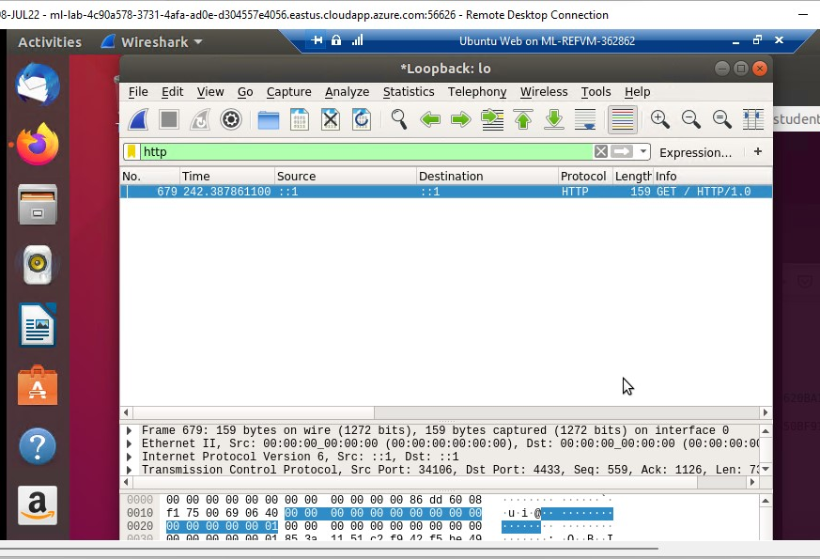
Creating and testing an SSL/TLS file
Take a screenshot of the output in Step 17.
It should show the GET request in the Info column.

Slide 9
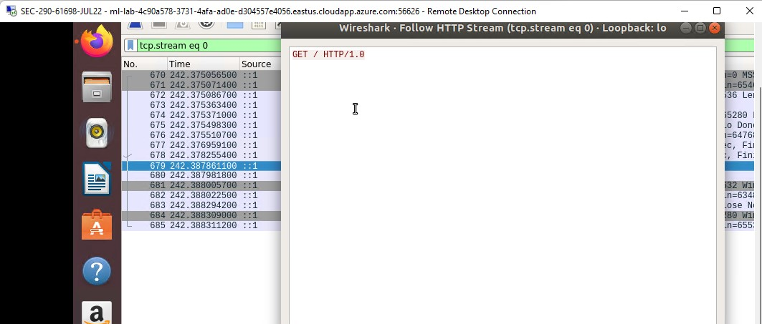
Creating and testing an SSL/TLS file cont’d
Take a screenshot of the output in Step 20.
It should show the decrypted SSL stream.

Slide 10
References
Google
https://devry.webex.com/recordingservice/sites/devry/recording/06137512eab6103abfbf00505681e27f/playback

Slide 11
Module 4: Snort
In this module I will explore Snort, an open-source Network Intrusion Detection System (NIDS), by testing and creating Snort rules. I also used, Sguil which provides a web form front-end for real time analysis if IDS alerts.

Slide 12
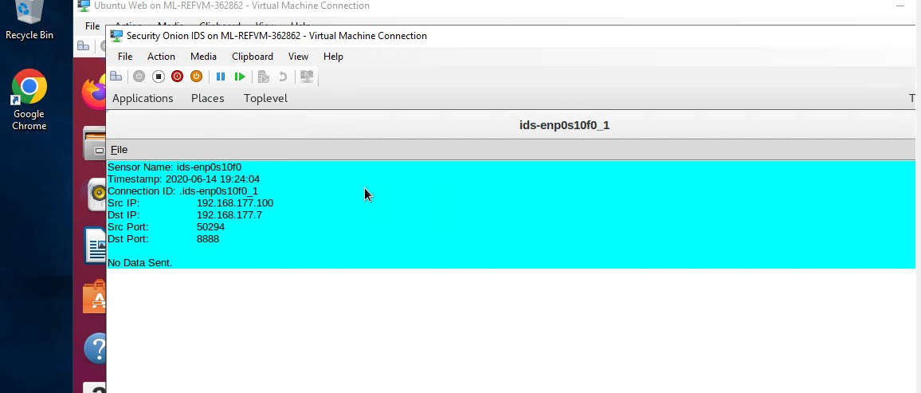
Testing Snort rules
Take a screenshot of the output in Part 1 Step 8.
It should show the transcript of the XMAS scan alert.

Slide 13
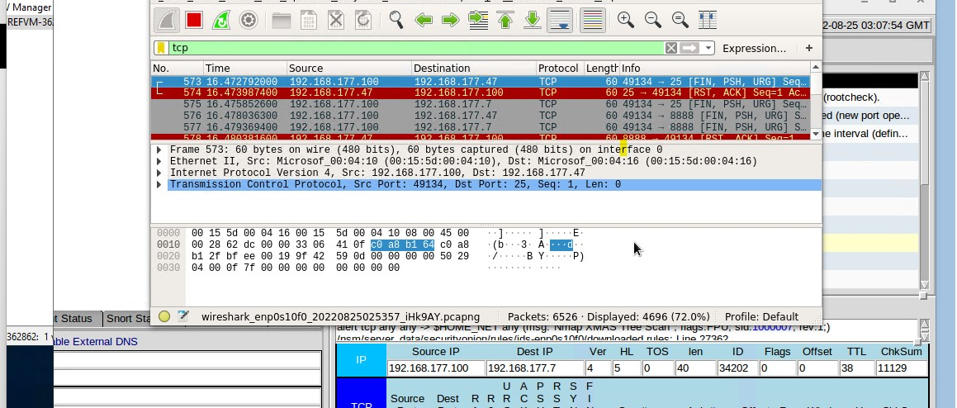
Testing Snort rules cont’d
Take a screenshot of the output in Part 1 Step 10.
It should show the TCP packets generated by the XMAS scan.

Slide 14
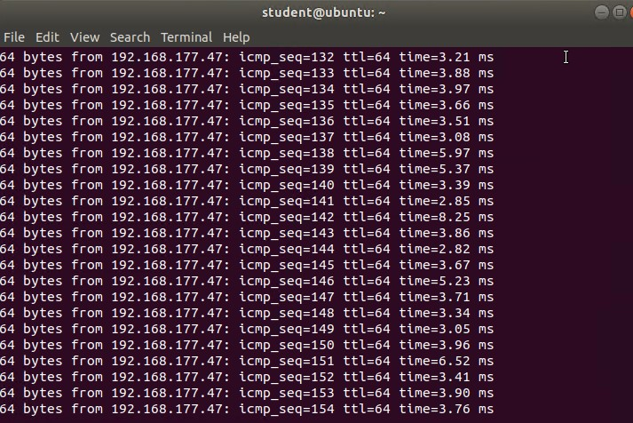
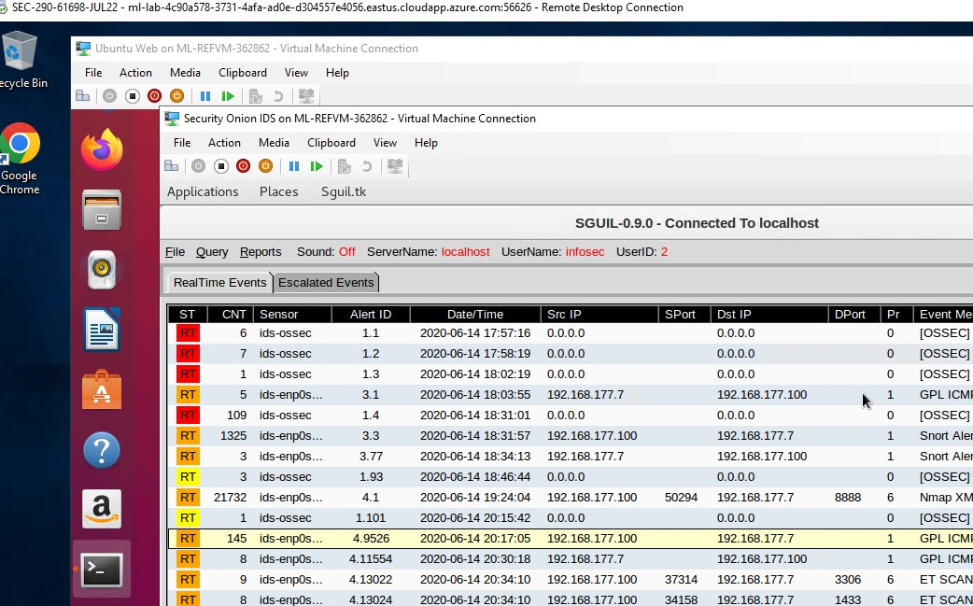
Creating Snort rules
Take a screenshot of the output in Part 2 Step 5.
It should show the ping activity alert.

Slide 15
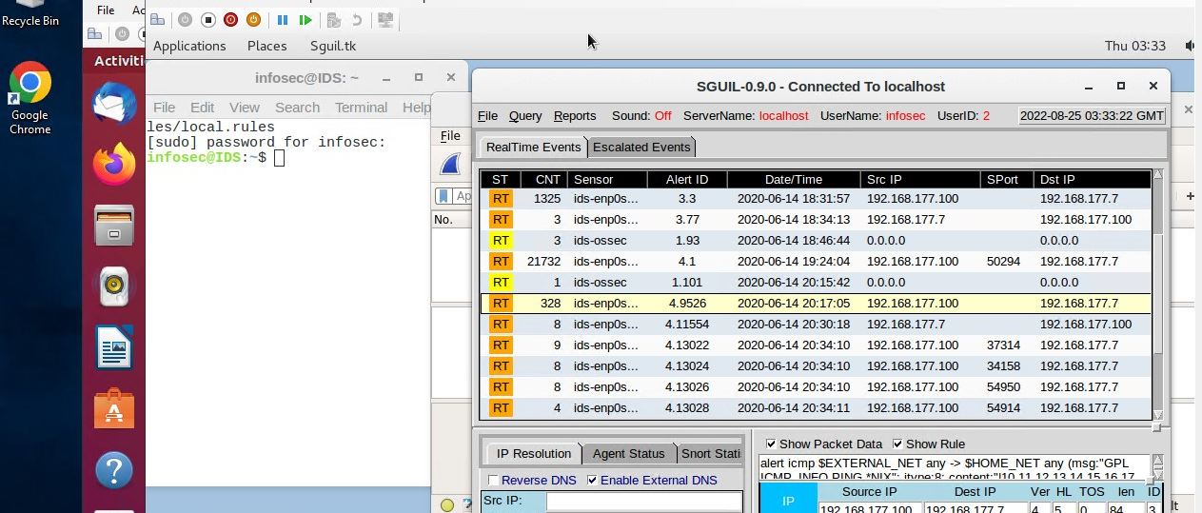
Creating Snort rules cont’d
Take a screenshot of the output in Part 2 Step 6.
It should show the ICMP packets generated by the ping activity.

Slide 16
Module 5: Live Memory Analysis
In this module I gained familiarity with Linux and Microsoft tools that will allow us to conduct live memory analysis, including topics below:
Linux Processes
Process Hacker
Process Monitor
Volatility

Slide 17
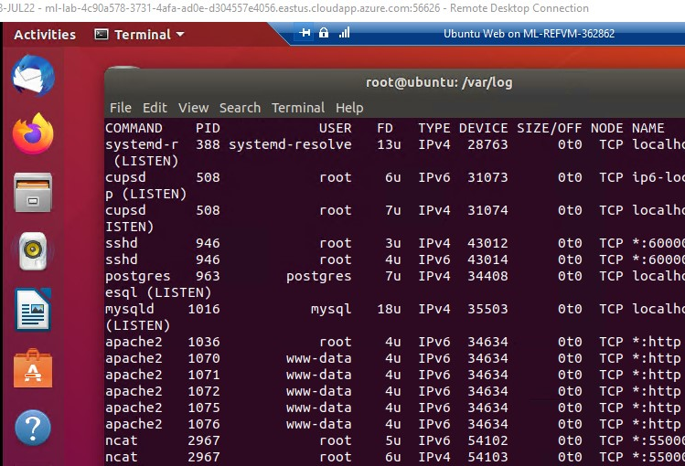
Linux Processes
Take a screenshot of the output in Part 1, Step 13.
It should show port 55000 open for both IPv4 and IPv6.

Slide 18
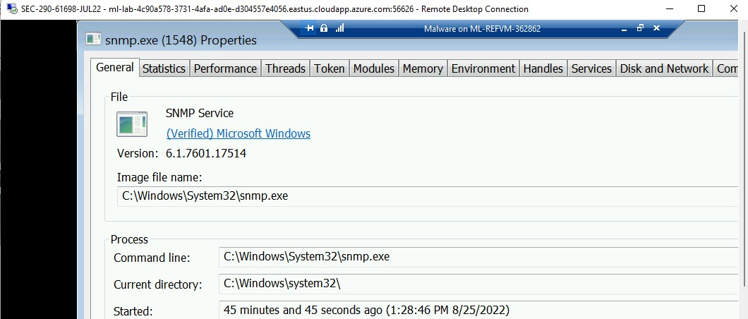
Process Hacker
Take a screenshot of the output in Part 2, Step 5.
It should show properties of a chosen process.

Slide 19
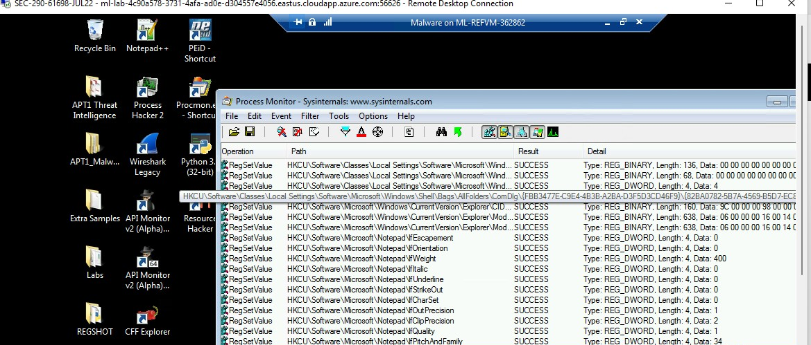
Process Monitor
Take a screenshot of the output in Part 3, Step 12.
It should show ifFaceName in the Path column and Data: Roman in the Detail column.

Slide 20

References
…https://lms.devry.edu/lms/content/1650/64842/SEC290/SEC290%20Module%205%200322.pdf
1
…https://devry.webex.com/recordingservice/sites/devry/recording/playback/dba9342ef5c1103a9d7f00505681ae70
2

Slide 21

Module 6: Firewall
In this Module I will configure iptables for network defense in six scenarios:
Time-based access
Blackhole routing
Bogon Filtering
Stateful firewall
Dynamic NAT
Brute forcing of SSH logins

Slide 22
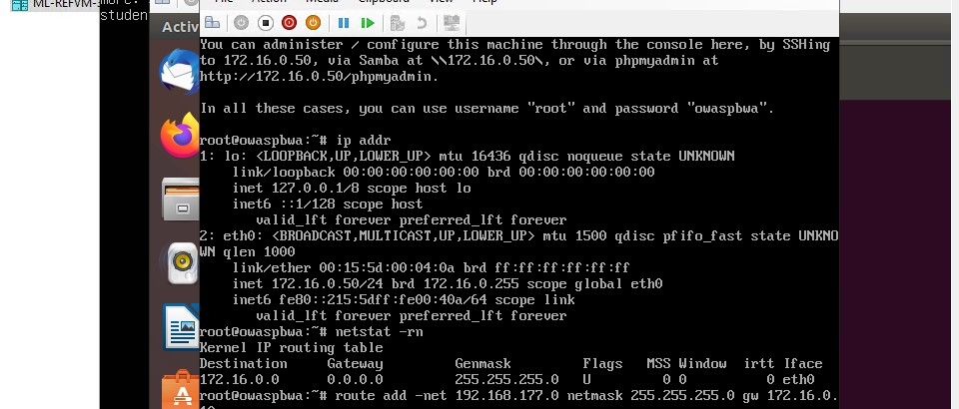
Time-based Access
Take a screenshot of the output in Part 1 Step 18.
It should show the output of the DMZ Route Table.

Slide 23
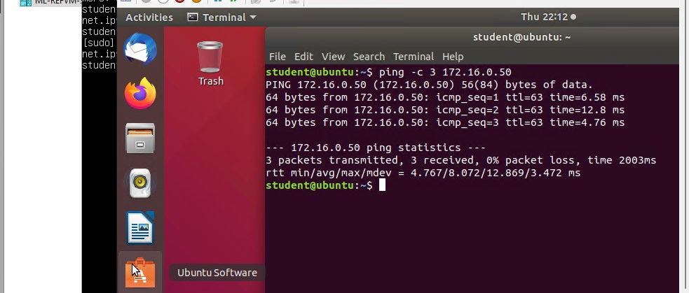
Time-based Access
Take a screenshot of the output in Part 1 Step 23.
It should show a successful ping from the Ubuntu Web VM and the DMZ VM.

Slide 24
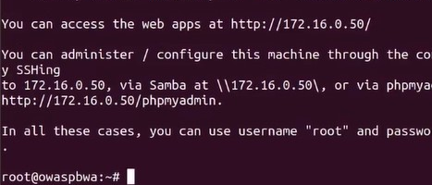
Time-based Access
Take a screenshot of the output in Part 1 Step 33.
It should show two time-based access rules in the FORWARD chain

Slide 25

References
…https://devry.webex.com/recordingservice/sites/devry/recording/a0999e48fb43103a8fa100505681ae70/playback
…https://lms.devry.edu/lms/content/1650/64842/SEC290/SEC290%20Module%206%200322.pdf

Slide 26
CHALLENGES
I was working on some VMs that I was not fully acquainted with and it took me time to adjust initially. The VMs were slow loading and connections would drop at times. My screen was small so had to struggle with finding some icons. Hence, had to check small display by default to be able to see all icons on the VMs desktops.

Slide 27
CAREER SKILLS
How to use IDS tools.
How to use VPN.
Network Trafic Monitoring.
Dta backup and recovery, incident handling.
How to prevent a firewall from being bypassed, and its policy.
Setting up server security such as time-based access and Blackhole routing.
Using nmap to scan for open ports
How to use different VMs

Slide 28
CONCLUSION
With some basic understanding of Infrastructure security, I now feel more confident about my future in IT industry. It was a great learning experience but requires time and practice to excel!

