Slide 1


SEC285 FINAL COURSE PROJECT ON FUNDAMENTALS OF INFORMATION SYSTEM SECURITY
PRESENTED BY: MARYAM ZISHAN

Slide 2
INTRODUCTION
This PowerPoint demonstrated a detailed summary of knowledge I gained over 8 weeks in SEC285 Fundamentals of Information System Security at DeVry University under the directions of Professor Jack Sibrizzi.

Slide 3
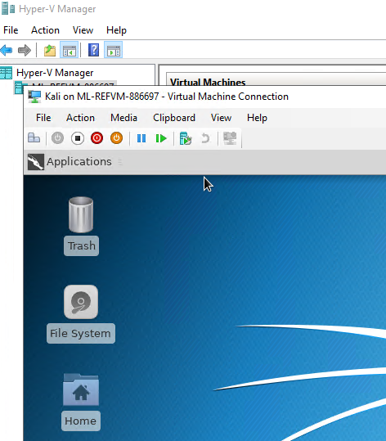
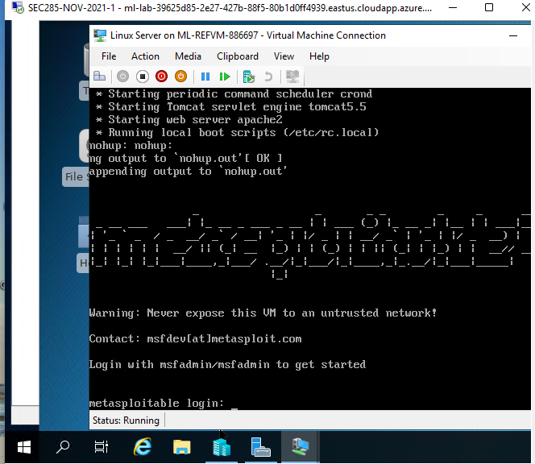
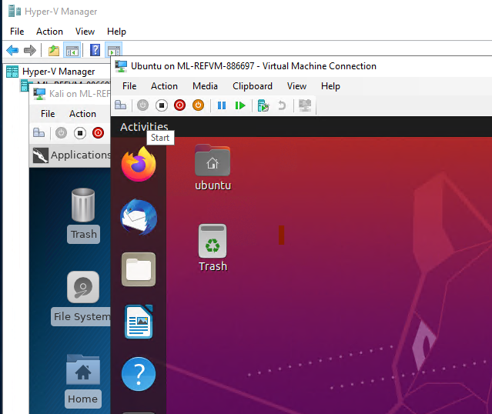
Screenshot of Installed Linux Ubuntu, Kali Linux and Linux Server downloaded from software called VMware workstation through Azure Lab Services

Slide 4
SEC285
Module 2
Asymmetric Key Encryption

Slide 5
Activity | Requirement(s) | Points
File Encryption | Screenshot | 15
File Decryption | Screenshot | 15
Rubric

Slide 6
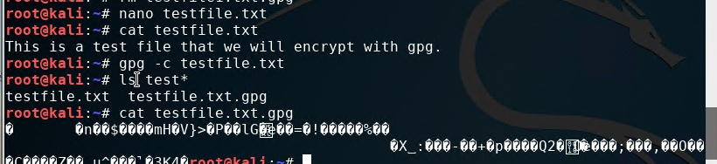
File Encryption
This screenshot should show the following.
Content of the plaintext file
Content of the encrypted file

Slide 7
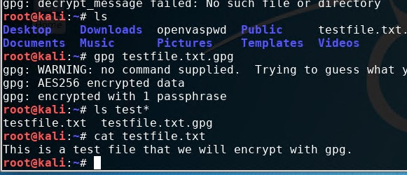
File Decryption
This screenshot should show the following.
The encrypted file being listed by itself
The decrypting process
Both the encrypted file and the original plaintext file being listed

Slide 8
SEC285
Module 3
Stateful Firewall
Here firewall is used to protect enterprise computing resources from risks using Kali Linux and Linux Server.

Slide 9
UDP & TCP
In this module I learned to harden a Linux server by setting up a stateful firewall with iptables.
Most enterprise organizations use applications: transmission control protocol (TCP) and user datagram protocol (UDP).
UDP is a connectionless protocol. UDP endpoints simply send their datagrams in hope that they arrive at their destination intact. Examples of UDP applications include name resolution (DNS) and dynamic IP address assignment (DHCP).
TCP is a reliable, connection-oriented protocol. Examples of TCP applications include file transfer (FTP), web (HTTP), and email (SMTP). TCP uses a three-way handshake in order to establish a session between a client and a server.
· Client initiates connection by sending a TCP SYN packet.
· Server may reply with a SYN ACK packet.
· Client then concludes the connection with an ACK packet.
Prior to the three packet exchanges above, the endpoints cannot begin data transfer. Once the server receives the last ACK packet, the TCP session is considered being in the established state.
The keyword "established" will be used later when you configure the stateful firewall.
Reference:
SEC285 Project Guide

Slide 10
Question
What effect does the sudo iptables --policy INPUT DROP command have on the access to computing resources?
Answer here: Rules for filtering packets are put in place using the “iptables” command. The user-space application program “iptables” allows configuring the tables provided by the Linux kernel firewall, as well as the chains and rules it stores.The following aspects of the packet are most often used as criteria:
Packet Type — Specifies the type of packets the command filters.
Packet Source/Destination — Specifies which packets the command filters based on the source or destination of the packet.
Target — Specifies what action is taken on packets matching the above criteria.
When looking at the structure of an “iptables” command, it is important to remember that, unlike most other commands, the length and complexity of an “iptables” command can change based on its purpose. A command to remove a rule from a chain can be very short, while a command designed to filter packets from a particular subnet using a variety of specific parameters and options can be rather lengthy. When creating iptables commands, it is helpful to recognize that some parameters and options may create the need for other parameters and options to further specify the previous option's request. To construct a valid rule, this must continue until every parameter and option that requires another set of options is satisfied.
The chain names indicate which traffic the rules in each list will be applied to, input is for any connections coming to your cloud server, output is any leaving traffic and forward for any pass through. Each chain also has its policy setting which determines how the traffic is handled if it doesn’t match any specific rules, by default it’s set to accept.
The default behavior of the three chains can be determined by using the sudo iptables –policy input and output command. This command essentially displays the chains and the rules applied to them by default if any. Using the accept option you allow a certain chain to receive internet packets from that chain whether incoming or outgoing. While the deny policy changes the input and output to not send nor receive packets from the internet with a certain chain.
Reference:
Google

Slide 11
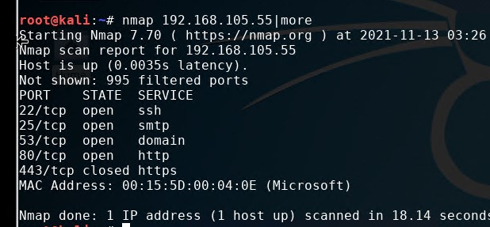
Nmap Scan
This screenshot should show the Nmap scan result of the Linux Server VM.

Slide 12
SEC285
Module 4
Bring Your Own Device (BYOD)
Security Policy
I will create the bring your own device (BYOD) security policy for BYOD Corporation based on a SANS security policy template.

Slide 13
Introduction
Security policies are high-level statements approved by senior management to guide the behavior of people who come into contact with organizational computing resources. A security policy is a set of documents that clarify an organization’s expectations regarding the proper usage of their computing resources. It specifies which behaviors are considered acceptable and which are not.
There are three categories of security policies: program policy, issue-specific policy, and system-specific policy.
A program policy sets the direction of a security program. It allocates appropriate resources to ensure that the security program is effectively implemented. An issue-specific policy focuses on specific technologies implemented in an organization, such as email and virtual private networks (VPNs). A system-specific policy deals with technologies (similar to an issue-specific policy), as well as addressing security personnel and configurations of the said technologies.
All security practitioners must become familiar with the process of crafting an effective security policy, as outlined in this project module. There are many sample SANS security policies. Reading these policies helps you understand what needs to be included in each section of a security policy.
Reference:
SEC285 Project Guide

Slide 14
BYOD Security Policy
This slide should have the complete security policy template inserted as an object.

Slide 15

SEC285
Module 5
Multifactor Authentication (MFA)
Mostly end users use a single password to access all computers in an enterprise. This process is known as single sign-on and can be vulnerable to threats. Hence, to reduce risks of possible threats they now make use of multifactor authentication (MFA) utilizing regular password and a time-based one-time password (OTP).In this module I generated one-time password by using the Google Authenticator app available to Android and iOS devices.

Slide 16
Multifactor Authentication(MFA)
In this module I implemented security control to protect enterprise computing resources, by using multifactor authentication (MFA). To address security concerns, a Linux administrator must be able to disable unnecessary services, enhance user management, implement a stateful firewall to allow access from approved hosts only, enhance logging and network time management, implement an effective patch management system, encrypt data at rest and in transit, enforce logging of activities on the server, be able to implement security controls to protect against dictionary and brute force attacks, enforce forensic deletion of files, etc.

Slide 17
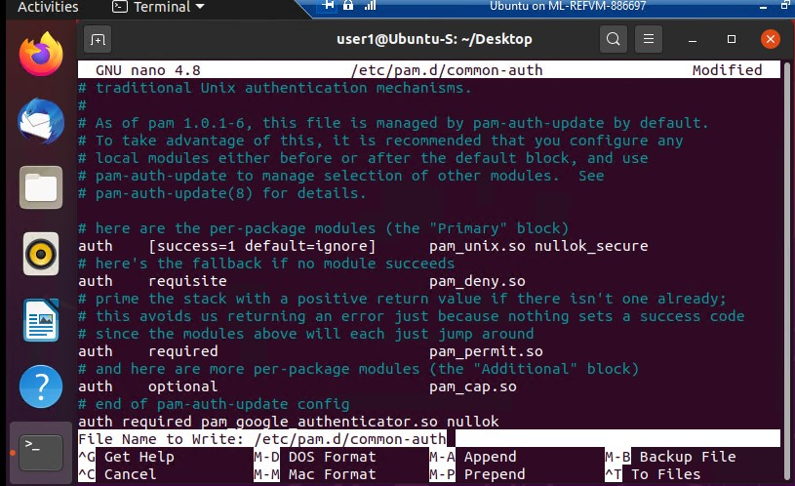
Common-auth Configuration File
This screenshot should show the entry that indicates the use of the Google Authenticator module.

Slide 18
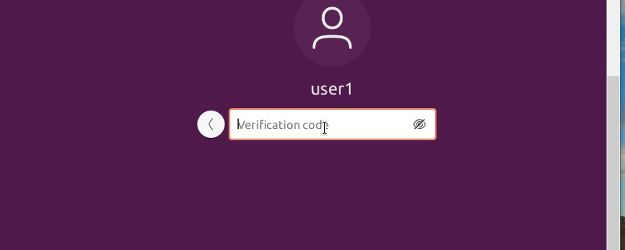
MFA Logon Screen
This screenshot should show the logon screen where a verification code is required.

Slide 19
SEC285
Module 6
Vulnerability Assessment
Here I explores three vulnerability tools such as NMAP(the network mapper), Netcat, and Wireshark using the Kali VM, Linux Server and Ubuntu, respectively.

Slide 20
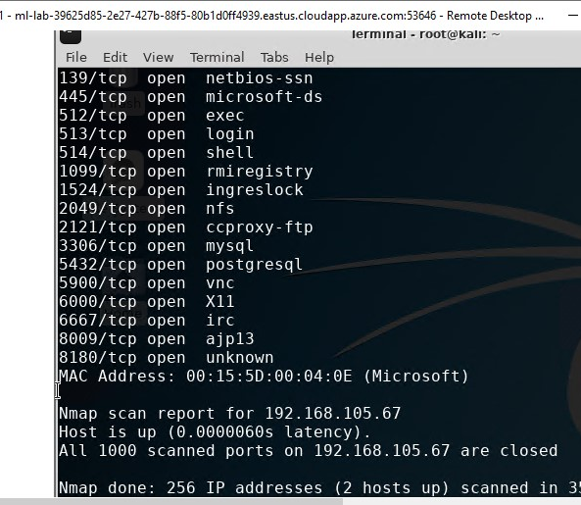
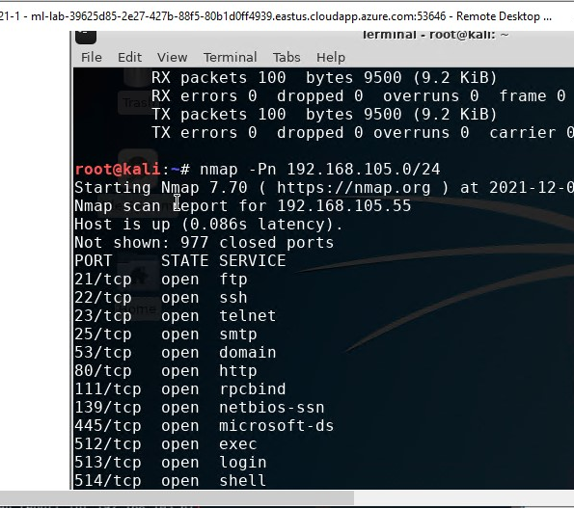
Nmap
The NMAP tool can be used to identify IP addresses that are in use on a network segment, assuming that the hosts on the network segment are up and running.
This screenshot should include the scan result showing both the Kali and Linux Server VMs.

Slide 21
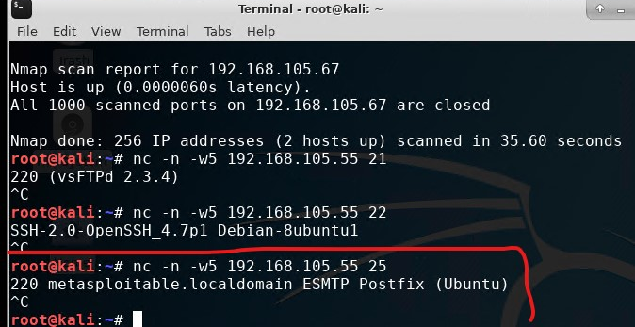
Net Cat
The NetCat tool can be used to gain information about FTP, SSH, and SMTP applications that are discovered in an NMAP scan (called banner grabbing). Knowing the version of an application running on the server can be a great help in the exploitation phase.
This screenshot should include the scan result showing both the Kali and Linux Server VMs.

Slide 22
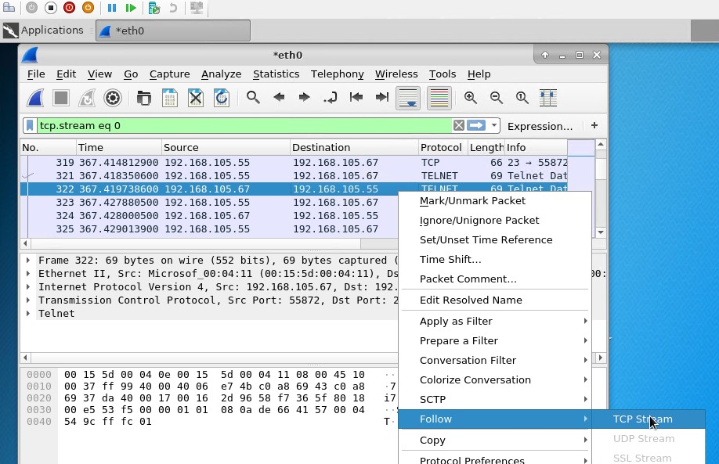
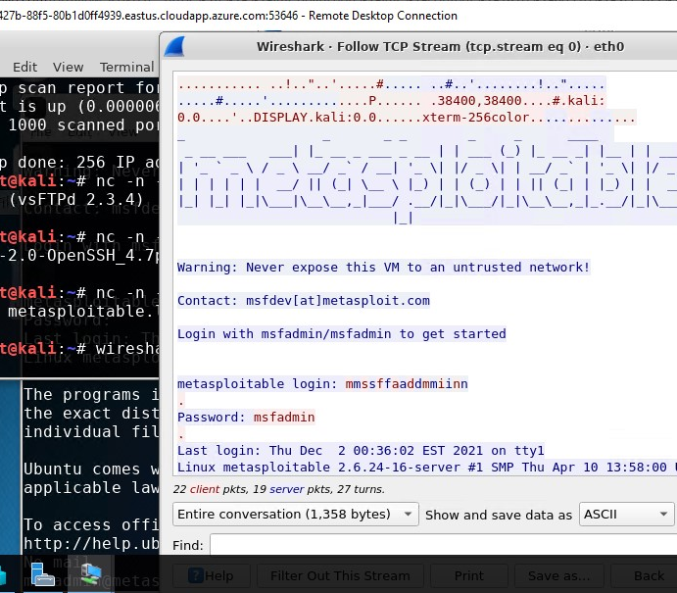
Wireshark
Wireshark is a packet sniffing tool. It can be used by security practitioners to analyze network traffic and gain insight into client and server applications.
This screenshot should include the Wireshark—Follow TCP Steam window showing the Telnet username and password.

Slide 23
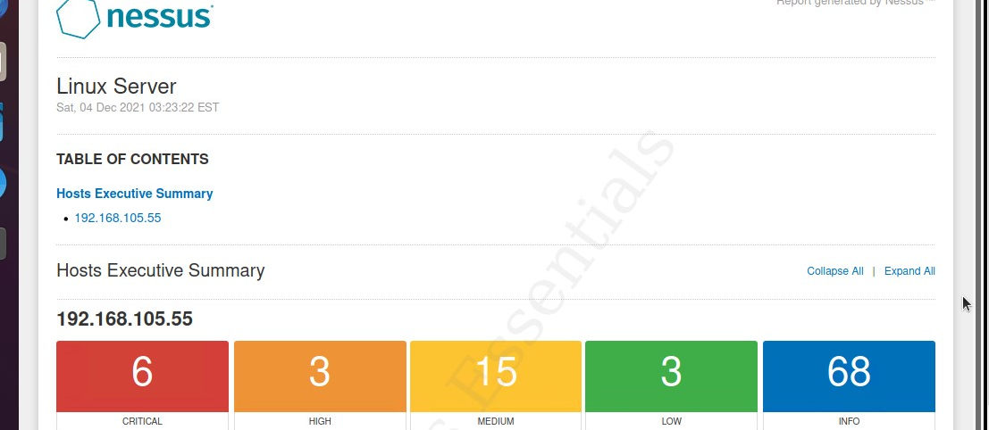
Nessus
Nessus Essentials is a free vulnerability scanner that provides an entry point for vulnerability assessment.
This screenshot should include the high-level view of the Nessus vulnerability scan report (showing categories of vulnerability in different colors).

Slide 24

CHALLENGES
Below is the list of some of the challenges I had to face as a beginner during this course project:
Learning about cryptography
Cyber attacks
Network protection and device security
Encryption and Decryption
Learning about various formulas
Usage of vulnerability assessment tool

Slide 25
CAREER SKILLS
Basic career skills that I acquired during this course project are:
Thinking with patience before proceeding.
Security analysis
Encryption
Decryption
Multifactor Authentication(MFA)
Utilization of Vulnerability assessment tools
Writing of company’s security Policy
Firewall Application
Kali Linux
Linux Server
Ubuntu

Slide 26

CONCLUSION
With some basic understanding of Information System Security, I now feel more confident about my future in IT. It’s been interesting experience but requires time and practice to excel!

